Slide 1
Religious Trojan Horse By Brannon Howse© This curriculum is protected by federal copyright laws

Slide 2
Introduction: The Bible Predicted the Religious Trojan Horse, and We Are Called to Expose It

Slide 3
Acts 20:28-31 declares: Therefore take heed to yourselves and to all the flock, among which the Holy Spirit has made you overseers, to shepherd the church of God which He purchased with His own blood. For I know this, that after my departure savage wolves will come in among you, not sparing the flock.

Slide 4
Also from among yourselves men will rise up, speaking perverse things, to draw away the disciples after themselves. Therefore watch, and remember that for three years I did not cease to warn everyone night and day with tears.

Slide 5
These false teachers speak perverse things. The word “perverse” actually means “to speak distorted or twisted things”.

Slide 6
Today, false teachers promote a form of godliness but deny the God and Biblical gospel spoken of in 2 Timothy 3:5: “having a form of godliness but denying its power. Have nothing to do with such people”.

Slide 7
Jude 3 also Warns of the Religious Trojan Horse When We Read: For certain men have crept in unnoticed, who long ago were marked out for this condemnation, ungodly men, who turn the grace of our God into lewdness and deny the only Lord God and our Lord Jesus Christ.

Slide 8
2 Peter 2:1-2: But there were also false prophets among the people, even as there will be false teachers among you, who will secretly bring in destructive heresies, even denying the Lord who bought them, and bring on themselves swift destruction. And many will follow their destructive ways, because of whom the way of truth will be blasphemed.

Slide 9
Paul, in 2 Timothy 3:12: “Yes, and all who desire to live godly in Christ Jesus will suffer persecution.”

Slide 10
The Word of God Defines our Biblical Mission: • Defend the Gospel—1 Timothy 6:20, 2 Timothy 1:13, 2:25; • Proclaim the Gospel—1 Corinthians 15:3-4, 2 Timothy 1:8, 2:15, 4:2; • Suffer for the Gospel—2 Timothy 1:8, 2:3, 2:8-9, 3:12, 4:2; • Rejoice in the Gospel—Romans 8:18, 2 Timothy 4:7-8.

Slide 11
Romans 8:18: “For I consider that the sufferings of this present time are not worthy to be compared with the glory which shall be revealed in us.”

Slide 12
2 Timothy 4:7-8: I have fought the good fight, I have finished the race, I have kept the faith. Finally, there is laid up for me the crown of righteousness, which the Lord, the righteous Judge, will give to me on that Day, and not to me only but also to all who have loved His appearing.

Slide 13
Is It Negative and Unbiblical to Name False Teachers?

Slide 14
Second Timothy 4:3: “For the time will come when they will not endure sound doctrine; but after their own lusts shall they heap to themselves teachers, having itching ears.”

Slide 15
In John 10:11-13, Jesus says we will encounter some who claim to be shepherds or pastors but really have little concern for the sheep: I am the good shepherd: the good shepherd giveth his life for the sheep.

Slide 16
But he that is an hireling, and not the shepherd, whose own the sheep are not, seeth the wolf coming, and leaveth the sheep, and fleeth: and the wolf catcheth them, and scattereth the sheep. The hireling fleeth, because he is an hireling, and careth not for the sheep.

Slide 17
Is it negative and unbiblical to name false teachers?

Slide 18
In 2 Timothy the Apostle Paul Names Numerous People: ∙ 1:15—Phygellus and Hermogenes ∙ 2:17—Hymenaeus and Philetus, ∙ 3:8—Jannes and Jambres, ∙ 4:10—Demas, ∙ 4:14—Alexander the coppersmith.

Slide 19
In 3 John 9, John names Diotrephes. Jesus called out false teachers in Matthew 23 and Luke 11.

Slide 20
Ephesians 5:11 Makes it Clear We Are to Expose False Teachers: “And have no fellowship with the unfruitful works of darkness, but rather expose them.”

Slide 21
1 Timothy 6:5: “who have been robbed of the truth and who think that godliness is a means to financial gain”.

Slide 22
False teachers give sheep the opportunity to test the commitment of their shepherds/pastors.

Slide 23
Show me a shepherd who will not name false teachers, and I will show you a hireling.

Slide 24
Pastor Jim Bublitz Offers Further Insight into the Positive Results of Identifying False Teachers by Name: From those words it is clear that God allows teachers of error for the same reason as He does persecutors of His people: to test their love, to try their fidelity,

Slide 25
Pastor Jim Bublitz: to show that their loyalty to Him is such that they will not give ear unto His enemies. Error has always been more popular than the Truth, for it lets down the bars and fosters fleshly indulgence, but for that very reason it is obnoxious to the godly.

Slide 26
Pastor Jim Bublitz: The one who by grace can say “I have chosen the way of Truth” will be able to add “I have stuck unto Thy testimonies” (Psalm 119:30, 31), none being able to move him therefrom.

Slide 27
Committed Christians must publicly name false teachers because it is impossible to privately correct public false teaching.

Slide 28
The Late Vance Havner Wrote: “We live what we believe; the rest is religious talk.” Living what we believe includes our willingness to name false teachers and to endure the criticism and persecution that will surely follow. To do any less is treason to our calling, to our mandate, to our Lord and Savior Jesus Christ.

Slide 29
When we expose false teaching and false teachers, we proclaim and defend the authority, accuracy, and application of God’s Word—the very thing false teachers seek to undermine.

Slide 30
Living what we believe requires speaking biblical truth and warnings no matter how offensive it may be to the spiritually immature, the nondiscerning, or the wolves that creep in among the sheep.

Slide 31
Jude 3-4: Beloved, when I gave all diligence to write unto you of the common salvation, it was needful for me to write unto you, and exhort you that ye should earnestly contend for the faith

Slide 32
Jude 3-4: which was once delivered unto the saints. For there are certain men crept in unawares, who were before of old ordained to this condemnation, ungodly men, turning the grace of our God into lasciviousness, and denying the only Lord God, and our Lord Jesus Christ.

Slide 33
Truth is never negative to those who seek to serve the truth.

Slide 34
False Arrest: Confronting the Politically Correct Matthew 18 Police

Slide 35
In context, it is clear that Matthew 18:15-17 address how to handle a private sin issue and how to conduct church discipline.

Slide 36
PCM18s would have you believe Matthew 18 means you should never write or speak publicly to oppose one of their gurus unless you first speak to that person privately. This is just an absurd manipulation of Scripture.

Slide 37
What the PCM18s don’t want you to know is that throughout the New Testament the great apostle Paul himself publicly denounced false teachers by name without first going to them in private.

Slide 38
How can one privately correct public false teaching? It can’t be done, and that’s exactly why we are to publicly point out erroneous teaching once it has been promoted in books, television, radio, websites, and other public forums.

Slide 39
Churches and Christian Media Censor the Truth

Slide 40
In his 1983 message Dr. Walter Martin predicted with pinpoint accuracy the condition of evangelicalism and how censorship of Biblical truth by self-described evangelicals would increase before the Lord’s return.

Slide 41
Dr. Walter Martin Proclaimed: You see, the attitude of the Christian media is don’t rock the boat, and the Christian Church is suffering from that disease today by its Latin name, non rock-a-boat-us. Whatever you do, non rock-a-boat-us ecclesiastic-us. Don’t shake, rattle and roll the boat of the Church. Leave us alone….

Slide 42
Dr. Walter Martin Proclaimed: They’re always screaming about secular humanism censoring the Christian Church, but they’re the ones that are censoring the Christian Church. They don’t want to get on television and on radio and tell it like it is. You know why? Because then they won’t get any checks from people out there whose feelings they hurt.

Slide 43
Dr. Walter Martin Proclaimed: So, they are not governed by the Holy Spirit. They are not governed by the authority of the Scriptures which commands them to tell the truth. They are governed by the almighty checkbook of the people that are listening.

Slide 44
May neither you nor I allow the love of money to cause us to stray from proclaiming the truth.

Slide 45
I Timothy 6:10 Warns: “For the love of money is a root of all kinds of evil, for which some have strayed from the faith in their greediness, and pierced themselves through with many sorrows.”

Slide 46
Lesson 1 The Grave Influence of the Religious Trojan

Slide 47
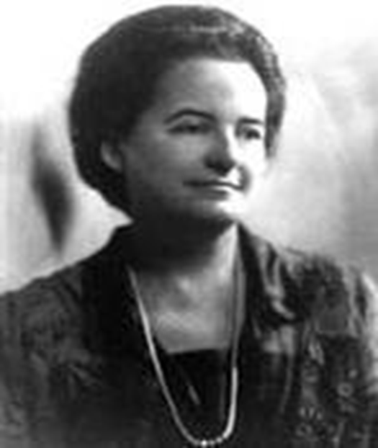
Alice Bailey (1880-1949)

Slide 48
Alice Bailey wrote 24 books totaling thousands of pages, books she claimed to have written under the direction of a spirit guide called the Tibetan. But to be clear: Alice Bailey was communicating with a demon, a practice strictly forbidden in the Bible.

Slide 49
The Tibetan Made a Number of Provocative Claims About The Future: This coming age will be as predominantly the age of group interplay, group idealism and group consciousness…for the will of the individual will voluntarily be blended into group will.

Slide 50
The future, in other words, will be about socialism—collectivism or group-thinking—not individualism or dissent.

Slide 51
Group-think, collectivism, and group consensus is now deliberately used in many mainline and “evangelical” churches to emotionally manipulate church members to conform to the desired goals and philosophies of church leaders.

Slide 52
Bailey and her demon predicted that the future and new order will be about: Pluralism: the belief that all religions are equal And Universalism: the belief that all roads lead to God.

Slide 53
Bailey and Her Demon Wrote: I refer to that period which will surely come in which an Enlightened People will rule; these people will not tolerate authoritarianism in any church…they will not accept or permit the rule of any body of men who undertake to tell them what they must believe in order to be saved….

Slide 54
Alice Bailey did not hide the fact that her worldview was founded in occultism, and she predicted that future churches—even those that once rejected her worldview—would eagerly accept it in order to attract the masses.

Slide 55
Since the Prediction by Alice Bailey: countless churches have wandered from defending a biblical worldview to teaching that the Word of God is subjective, that all roads lead to God, and that mysticism and pagan spirituality should be embraced to further one’s religious experiences.

Slide 56
Bailey & Her Demon Saw it Coming and Predicted: “It can be expected that the orthodox Christian will at first reject the theories about the Christ which occultism presents; at the same time, this same orthodox Christian

Slide 57
will find it increasingly difficult to induce the intelligent masses of people to accept the impossible Deity and the feeble Christ which historical Christianity has endorsed.”

Slide 58
The occult and mysticism have gone mainstream within evangelicalism in part because of the teachings of people like Joel Osteen, John Hagee, Kenneth Copeland, Rick Warren, and Robert Schuller.

Slide 59
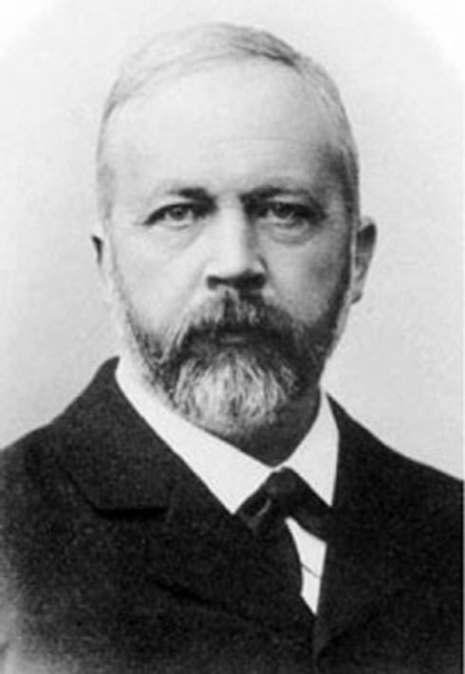
Julius Wellhausen (1844-1918)

Slide 60
In 1878, Julius Wellhausen, a German theology professor and author of numerous books “discovered” that the Bible is a book of stories but not the divinely inspired Word of God. He proclaimed his new truth to countless Germans and taught that the Bible could not be trusted, but human reason could.

Slide 61
Known as Higher Criticism or German rationalization, this was the contribution Julius Wellhausen offered to Germany’s cultural demise. The goal of Higher Criticism is to undermine the authority of God’s Word.

Slide 62
European Christianity was compromised and changed into a false religion from within as Higher Criticism led people into an essentially humanistic religion.

Slide 63
Germany was Hitler’s for the taking because absolute truth and the Gospel of Jesus Christ had long since been betrayed. Thus the German people came to believe that “the end justifies the means.”

Slide 64
Wellhausen’s liberal philosophy eventually jumped the ocean, became popular on the East Coast, and has spread throughout the United States and around the world.

Slide 65
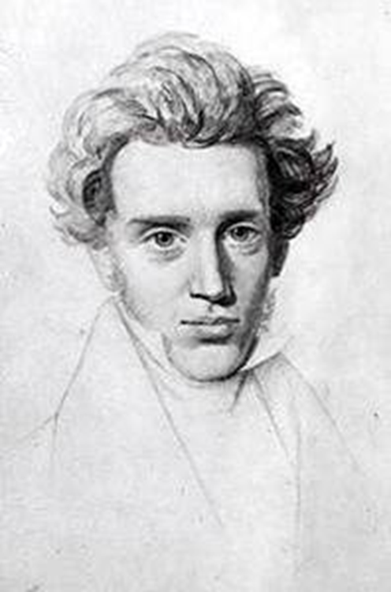
Søren Kierkegaard (1813-1855)

Slide 66
Søren Kierkegaard claimed to be a Christian but denied any consistent morality. Known as existentialism, his ideas gained steam in America a hundred years after his death. The central tenet of existentialism is that there is no absolute truth.

Slide 67
“Christians” practicing existentialism introduced what is called neo-orthodoxy. The American version of this movement grew popular in the 1960s and virtually took over in the 1970s and 1980s.

Slide 68
David Breese: A careful neglect of Calvary, the blood of Christ, divine forgiveness, original sin, and other great Christian themes. Salvation becomes experience-oriented, theology becomes contextual, and ultimate truth becomes contradictory. They announce that Jesus Christ came into the world to bring economic liberation to the oppressed masses of the earth.

Slide 69
Kierkegaard’s existentialism proclaimed that “truth is subjective,” a worldview very much alive today.

Slide 70
Kierkegaard’s existentialism and that of Friedrich Nietzsche differed radically. Kierkegaard applied his existentialism or subjective truth to his own brand of Christianity or spiritualism while Nietzsche applied it to his secular or naturalistic worldview.

Slide 71
In other words, Nietzsche applied the idea of subjective truth to the natural world as an atheist while Kierkegaard applied subjective truth to his brand of spirituality and called himself a Christian.

Slide 72
Kierkegaard’s unbiblical brand of Christianity has furthered the acceptance of Gnosticism. Paul warns of Gnosticism in Colossians 2:8-23; 1 Timothy 1:4; and 2 Timothy 2:16-19.

Slide 73
Gnosticism includes the worship of angels, the belief that salvation is not gained exclusively through the death, burial, and resurrection of Jesus Christ, and that truth can be obtained through mystical experience and practices.

Slide 74
As we will discover later, Gnosticism also elevated women to a role of savior of mankind, and it helps explain why the worship of Mary is so prevalent in the Gnosticism of the Catholic Church. Gnosticism and feminism are inextricably linked.

Slide 75
Nietzsche and Kierkegaard believed a person could not know truth and that people should reject absolutes.

Slide 76
Postmodernism, which is closely tied to existentialism, was introduced through the English departments of many American colleges and universities.

Slide 77
Postmodernists Seek To: deconstruct Western society by denying absolute truth even in the disciplines of reading and writing.

Slide 78
Postmodernists Within the American Church: deconstruct Christianity—as did Kierkegaard—by proclaiming that the Bible is not the absolute, inerrant, divinely inspired Word of God.

Slide 79
In rejecting traditional morality and values, existentialists uphold what they call an ethic of authenticity. You will also hear this phrase from the false church as it rejects traditional, orthodox Christianity for an “authentic” Christianity.

Slide 80
Liberal evangelicalism, like many liberal, mainstream churches, has rejected the idea of the return of Jesus Christ and His judgment of the world. Instead, they see it as their responsibility to build God’s kingdom through utopian ideals of the redistribution of wealth, the social gospel, disarmament, and a world community committed to social justice and pluralism.

Slide 81
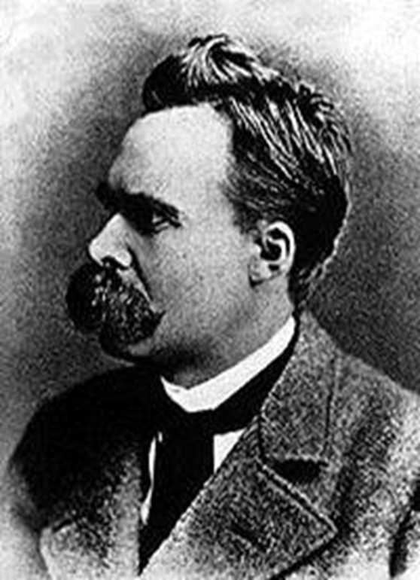
Friedrich Nietzsche (1844-1900)

Slide 82
Friedrich Nietzsche, along with Michael Foucault, founded postmodern thought.

Slide 83
Postmodernism holds that truth and reality are created by man and not by God, that something is true “if it works for you.”

Slide 84
Friedrich Nietzsche is one of the most widely read authors on college campuses.

Slide 85
How ironic that the false church is largely built on the worldview of a man best known for declaring “God is dead.” Nietzsche said not only that God is dead but that “we have killed him.” Nietzsche hated Christians.

Slide 86
Nietzsche Declared: “Christianity has been the most calamitous kind of arrogance yet,” he wrote. “I call Christianity the one great curse, the one enormous and innermost perversion, the one moral blemish of mankind….I regard Christianity as the most seductive lie that has yet existed.”

Slide 87
Nietzsche believed Christianity made his fellow Germans weak, so he described himself as “The Anti-Christian Friedrich Nietzsche” or sometimes as just “The Antichrist” (also the title of one of his books—Antichrist).

Slide 88
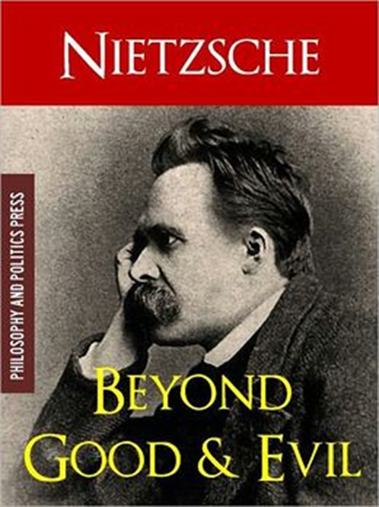
Nietzsche Proclaimed: “Life simply is will to power.” Whatever it takes, one should purpose to be a ruler, a master over the less desirable.

Slide 89
Nietzsche includes Christians among the weak because of their compassion for the sick, aged, and vulnerable. Anyone who holds to a fixed morality, he maintained, would become slaves—and deservedly so.

Slide 90
Nietzsche Believed: “…that the demand of one morality for all is detrimental for the higher men….” Notice that this is why today’s cultural elite have set one standard for the masses and a completely different one for themselves.

Slide 91
In contrast to Nietzsche, why do Christians have such a strong commitment to the life of the unborn, the sick, the disabled, and the elderly? Because we understand that man is created in the image of God.

Slide 92
Nietzsche promoted the concept of a “Superman” race, which Hitler also embraced after studying Nietzsche. Today, the Superman concept is welcomed through “spiritual evolution” which declares that man is evolving to new levels in the spiritual realm as more and more individuals discover their “god consciousness.”

Slide 93
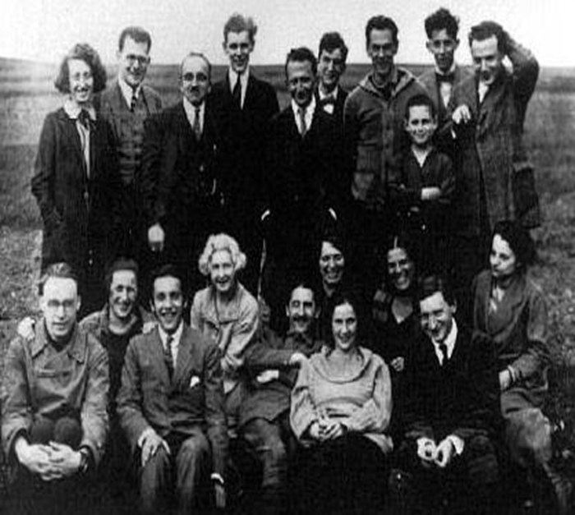
The Frankfurt School

Slide 94
In 1923, a group of German intellectuals started what has become known as The Frankfurt School.

Slide 95
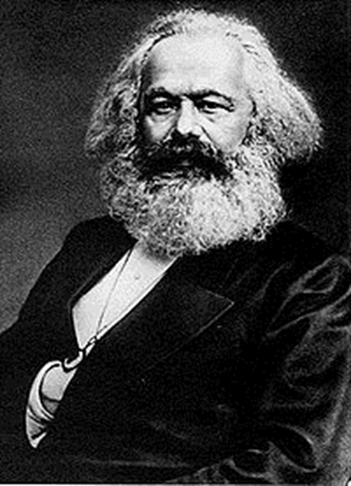
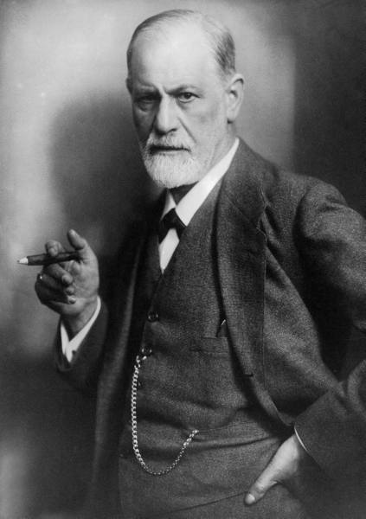
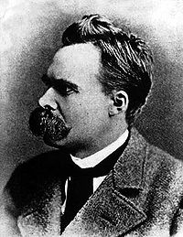
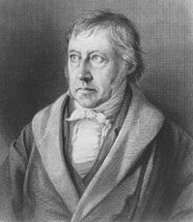
The Frankfurt School Followed: Marx Freud Nietzsche Hegel

Slide 96
William Lind Writes: The intended name for the Frankfurt School was the Institute for Marxism. The Institute’s father and funder, Felix Weil, wrote in 1971 that he “wanted the Institute to become known, and perhaps famous, due to its contributions to Marxism as a scientific discipline….”

Slide 97
Beginning a tradition Political Correctness still carries on, Weil and others decided that they could operate more effectively if they concealed their Marxism; hence, on reflection, they chose the neutral-sounding name, the Institute for Social Research (Insitut für Sozialforschung).

Slide 98
The Frankfurt School was directly connected to Karl Marx, Sigmund Freud, George Hegel and Friedrich Nietzsche.

Slide 99
Dr. Lind Writes: The Frankfurt School blended Marx with Freud, and later influences (some Fascist as well as Marxist) added linguistics to create “Critical Theory” and “deconstruction.”

Slide 100
These in turn greatly influenced education theory, and through institutions of higher education gave birth to what we now call “Political Correctness.” The lineage is clear, and it is traceable right back to Karl Marx.

Slide 101
In 1933, when the Nazis came to power in Germany, many members of the Frankfurt School found refuge in America at the invitation of John Dewey.

Slide 102
Chuck Morse Writes: The original strategy to destroy America, employed by the Frankfurt School, came from Italian Communist Antonio Gramsci, who realized that in order to achieve a Socialist victory, cultural institutions would have to be infiltrated and subverted. Gramsci realized that America, steeped in traditions of freedom and liberty, would never to succumb to a frontal assault.

Slide 103
Marcuse Described His Cultural Revelation This Way: “One can rightfully speak of a cultural revolution, since the protest is directed toward the whole cultural establishment; including the morality of existing society…there is one thing we can say with complete assurance.

Slide 104
The traditional idea of revolution and the traditional strategy of revolution has ended. These ideas are old-fashioned…what we must undertake is a type of diffuse and dispersed disintegration of the system.”

Slide 105
Cultural Marxism intends to destroy Christianity in all areas of life. The elimination of the Christian worldview will create the chaos necessary for Marxism to have its day. Once chaos has reached a fevered pitch, the public will cry out for government to solve the problem, and people will welcome socialism.

Slide 106
The author of this study believes our new financial system will be a mixture of socialism and capitalism called communitarianism.

Slide 107
Another of the goals of Frankfurt School faculty was the promotion of feminism, which is closely tied to Marxism and Gnosticism.

Slide 108
Dr. Gerald L. Atkinson, CDR, USN (Ret.), Describes the Attack on the American Male Through The Frankfurt School: “The Frankfurt school studied the ‘authoritarian personality’ which became synonymous with the male, the patriarchal head of the American family.

Slide 109
A modern utopia would be constructed by these idealistic intellectuals by ‘turning Western civilization’ upside down. This utopia would be a product of their imagination, a product not susceptible to criticism on the basis of the examination of evidence.

Slide 110
This ‘revolution’ would be accomplished by fomenting a very quiet, subtle and slowly spreading ‘cultural Marxism’ which would apply to culture the principles of Karl Marx bolstered by the modern psychological tools of Sigmund Freud. Thus, ‘cultural Marxism’ became a marriage of Marx and Freud aimed at producing a ‘quiet’ revolution in the United States of America.

Slide 111
This ‘quiet’ revolution has occurred in America over the past 30 years. While America slept! ‘The Authoritarian personality,’ studied by the Frankfurt School in the 1940s and 1950s in America, prepared the way for the subsequent warfare against the masculine gender promoted by Herbert Marcuse and his band of social revolutionaries under the guise of ‘women’s liberation’ and the New Left movement in the 1960s.

Slide 112
The evidence that psychological techniques for changing personality is intended to mean emasculation of the American male is provided by Abraham Maslow, founder of Third Force Humanist Psychology and a promoter of the psychotherapeutic classroom, who wrote that ‘...the next step in personal evolution is a transcendence of both masculinity and femininity to general humanness.’”

Slide 113
The Marxist revolutionaries knew exactly what they wanted to do and how to do it. They have succeeded in accomplishing much of their agenda.

Slide 114
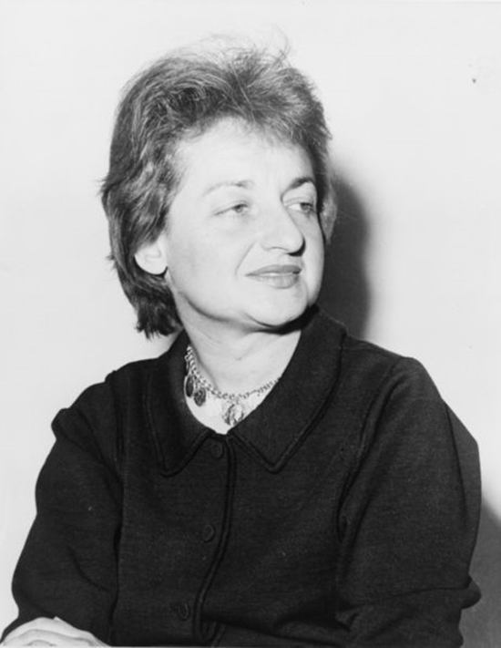
Betty Friedan (1921-2006)

Slide 115
Feminism is not about equal rights for women but about the feminization of all men. The feminist ideology is anti-family and anti-father.

Slide 116
Friedan was co-founder of the National Organization of Women (NOW), one of America’s most radical feminist organizations.

Slide 117
Friedan was an atheist who embraced Marxism.

Slide 118
As Benjamin Wicker Points Out: “Before she published The Feminine Mystique, Friedan had spent years in Marxist-inspired agitation on behalf of mistreated lower-class workers—and the abstractness of her analysis is fundamentally Marxist. She had been a Marxist since her college days at Smith in the late 1930s and early 1940s.

Slide 119
In the years after, she belonged to, worked for, or wrote positively about a string of leftist organizations and publications—like the Popular Front, the Federated Press, UE News, Congress of American Women, Jewish Life—that had significant Communist membership or Soviet sympathies.

Slide 120
Knowing that the call to revolution in The Feminine Mystique would be damaged if it was associated with the call to revolution in the Communist Manifesto, she hid her radical past.”

Slide 121
With the help of the feminist movement in the late 1960s, divorce laws were liberalized. The resulting drastic increase in divorce began to break down the strength, respect, and permanency of the marriage covenant in the civil arena.

Slide 122
Friedan and the cultural Marxists have used civil law, courts, and the media to destroy the family and fathers and to make possible the rise of the welfare nanny state.

Slide 123
The break-up of the family has been the leading cause of generational poverty and the permanent underclass. And the chaos is having its intended effect: the American people increasingly call for government to solve the problem by greater intervention into family life.

Slide 124
One consequence of the fall of man in the Garden of Eden is that women will challenge men for leadership (Genesis 3:16).

Slide 125
Many people in the Church now embrace feminism, and as a result, the biblical roles of men and women are not taught in most churches. While once only mainline liberal churches permitted women to teach men in the church, today many “evangelical” churches encourage women to teach men.

Slide 126
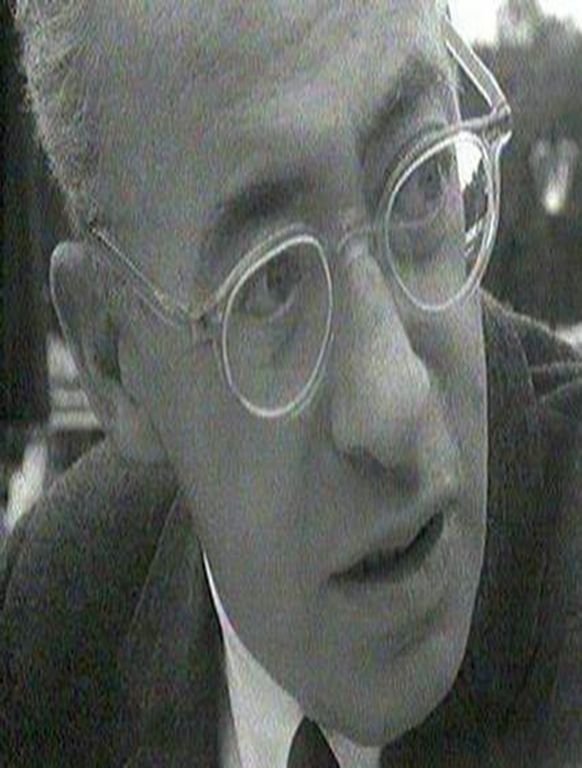
Saul Alinsky (1909-1972)

Slide 127
A young Italian Marxist by the name of Antonio Gramsci wrote of a “quiet” revolution—one that would transform a culture from within by changing the basic worldview of each and every institution in society.

Slide 128
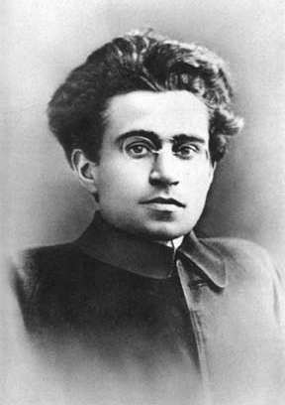
Gramsci Cautioned That This Revolution Would Be: “a long march through the institutions,” not a blitz of change.

Slide 129
Later in the twentieth century, Saul Alinsky codified the Gramsci dream in his 1971 book, Rules for Radicals: A Pragmatic Primer for Realistic Radicals.

Slide 130
In his book, Saul Alinsky detailed the need to penetrate the middle class and re-organize from within. Alinksy articulated tactics for infiltrating every conceivable social institution, including churches.

Slide 131
Alinsky’s dedication page of his book read: Lest we forget at least an over-the-shoulder acknowledgement to the very first radical; from all our legends, mythology, and history…the first radical known to man who rebelled against the establishment and did it so effectively that he at least won his own kingdom—Lucifer

Slide 132
Here are a few eye-opening excerpts from Rules for Radicals:

Slide 133
A Marxist begins with his prime truth that all evils are caused by the exploitation of the proletariat by the capitalists. From this he logically proceeds to the revolution to end capitalism, then into the third stage of reorganization into a new social order of the dictatorship of the proletariat, and finally the last stage…the political paradise of communism. (p. 10)

Slide 134
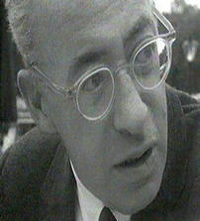
An organizer working in and for an open society is in an ideological dilemma to begin with, he does not have a fixed truth…truth to him is relative and changing; everything to him is relative and changing….To the extent that he is free from the shackles of dogma, he can respond to the realities of the widely different situations…. (pp. 10-11)

Slide 135
The first step in community organization is community disorganization. The disruption of the present organization is the first step toward community organization. Present arrangements must be disorganized if they are to be displaced by new patterns.... All change means disorganization of the old and organization of the new. (p. 116)

Slide 136
An organizer must stir up dissatisfaction and discontent.... He must create a mechanism that can drain off the underlying guilt for having accepted the previous situation for so long a time. Out of this mechanism, a new community organization arises....

Slide 137
The job then is getting the people to move, to act, to participate; in short, to develop and harness the necessary power to effectively conflict with the prevailing patterns and change them. When those prominent in the status quo turn and label you an “agitator” they are completely correct, for that is, in one word, your function—to agitate to the point of conflict. (p. 117)

Slide 138
Alinsky Made it Clear That The Infiltration of the Churches Was Part of His Goal: From the moment the organizer enters a community he lives, dreams... only one thing and that is to build the mass power base of what he calls the army.

Slide 139
Until he has developed that mass power base, he confronts no major issues.... Until he has those means and power instruments, his “tactics” are very different from power tactics. Therefore, every move revolves around one central point:

Slide 140
how many recruits will this bring into the organization, whether by means of local organizations, churches, service groups, labor Unions, corner gangs, or as individuals…. Change comes from power, and power comes from organization. (p. 113)

Slide 141
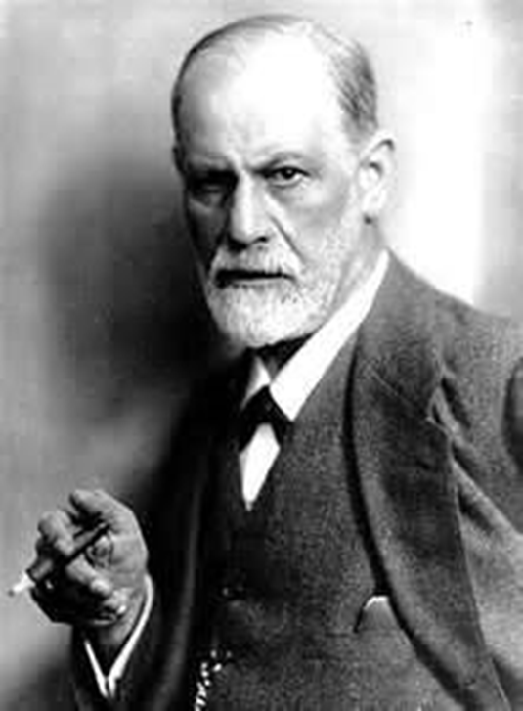
Sigmund Freud (1856-1939)

Slide 142
“To demolish religion with psychoanalytic weapons,” Freud biographer Peter Gay reported, “had been on Freud’s agenda for many years.”

Slide 143
In His book, The Future of an Illusion, Freud Describes His: “absolutely negative attitude toward religion, in every form and dilution.”

Slide 144
Benjamin Wiker, in Ten Books that Screwed Up the World, Explains the Roots of Freud’s Attitude:

Slide 145
Benjamin Wiker: We cannot forget Nietzsche’s assumption that religion was an entirely human creation. Since Freud read Nietzsche, this may have done as much as anything to help form his presentation of religion in The Future of an Illusion.

Slide 146
Wiker Describes Freud’s Perverted Worldview This Way: His rebellion took the form of baptizing as natural the most hideously unnatural sins, sins condemned by every society as the most unholy and unthinkable…. Freud damned as unnatural the Christian-based morality of Western society.

Slide 147
Freud Points Out Several “Unholy and Unthinkable” Inclinations: “Among these instinctual wishes are those of incest, cannibalism, and lust for killing.”

Slide 148
Freud believed that it is the people who reject a biblical worldview and follow their “natural” desires that are truly sane.

Slide 149
Dr. Wicker Explains Freud’s Evil is Good and Good is Evil Worldview This Way: “He [Freud] claimed that psychological disorders were the result of the unnatural repression of our naturally unholy and anti-social desires, and that some people just couldn’t handle the repression….

Slide 150
Therefore, neurotics are the only sane people because they react to unnatural frustration by training to reclaim their original, natural, asocial and amoral state. The result: the anti-social psychopath who kills without conscience is the most natural of all. The interesting effect of Freud’s proclamation that evil is natural was the seemingly unintended consequence of making psychopathic insanity natural.”

Slide 151
The Soul of a Soul-less Discipline

Slide 152
The word “psychology” derives from the Greek word “psyche,” the study of the soul—which, ironically, should be impossible for secular humanistic psychologists who deny the spiritual world and the soul.

Slide 153
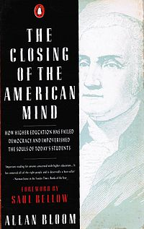
Author Alan Bloom Notes that for Secular Humanists: “the self is the modern substitute for the soul.” And when humanists refer to the mind, they really mean the brain.

Slide 154
The biblical worldview, of course, acknowledges both the spiritual and natural worlds. The brain is part of the natural world, but the mind and heart, as described in the Bible, are connected to the soul—the spiritual side of man.

Slide 155
Scripture mentions the heart 826 times, where “heart” refers to the core of a person’s being. Proverbs 4:23 says the heart is “the source of life.”

Slide 156
In Scripture, the words “heart” and “mind” are often interchangeable, and other times, they are complementary.

Slide 157
Your heart and mind are part of your soul, the core of your being that will still exist after you die. Souls will live forever and be judged by God (Romans 2:5; Revelation 2:23).

Slide 158
Romans 2:15 Points Out That People: “show the work of the law written in their hearts, their conscience also bearing witness, and between themselves their thoughts accusing or else excusing them.”

Slide 159
The conscience is part of the soul, and yet psychology denies the conscience by denying the soul and thus attempts to kill the conscience.

Slide 160
If People Ignore Their Guilty Conscience Long Enough or Often Enough, They Will Become People: “speaking lies in hypocrisy, having their own conscience seared with a hot iron” (1 Timothy 4:2).

Slide 161
Humanistic psychologists deny our sinful nature that results from the original sin of Adam and Eve. Instead, they believe man is simply a product of his environment.

Slide 162
As part of the denial of original sin and man’s depravity, psychology elevates man and claims that our problems do not stem from a sinful nature but from a lack of self-esteem.

Slide 163
Karl Marx (1818-1883)

Slide 164
An atheist and a secular humanist, Karl Marx wrote the Communist Manifesto with his friend Friedrich Engels.

Slide 165
Marx was such a reprobate that out of his six children, three died of starvation while still infants, two others committed suicide, and only one lived to become an adult.

Slide 166
Marx said: “Religion is the sigh of the oppressed creature, the sentiment of a heartless world, as it is the spirit of spiritless conditions. It is the opium of the people.” Marx Also Declared: “My object in life is to dethrone God and destroy capitalism.“

Slide 167
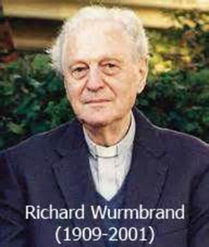
Wurmbrand Pleaded with Americans to Oppose Communism: The church can never have a peaceful coexistence with atheism. Everybody would laugh if I would say that health can peacefully exist with the microbe of tuberculosis, that the FBI can coexist peacefully with gangsters, that the church can peacefully exist with drunkenness, but communism and atheism is much worse than drug addiction and drunkenness.

Slide 168
You drink a little wine and the next day it passes, but communism poisons youth and our children since 50 years. How can there be peaceful existence with this on the side of churchmen and the church leadership I cannot understand .

Slide 169
Pastor Wurmbrand explained that communists do not really care whether or not people become communists per se but only that they do not oppose communism.

Slide 170
In 1966 Wurmbrand Warned: Romanian Communists are very interested in the fact that you have here in the States, something like 300,000 [liberal clergy] on their side. They can’t very well win them for Communism, but they can win them for a leftwing Christianity which supports Communism.

Slide 171
Social justice is a masking term for the economic philosophies of communism and socialism.

Slide 172
Social justice promotes the redistribution of income in the name of “the common good.”

Slide 173
The term “social justice” was coined by a Catholic Jesuit. Luigi Taparelli D’Azeglio, who lived from 1793 to 1862.

Slide 174
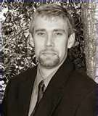
Author and research Carl Teichrib, Explains That Many Denominations Now Actively Promote “Social Justice”: In today’s Christian world—and Western culture in general—there’s a myriad of changes taking place, and with it comes new language.

Slide 175
“Social Justice” is certainly in the spotlight. Jim Wallis of Sojourners uses this term repeatedly. Brain McLaren’s book Everything Must Change seeks to reframe Christianity in a social justice context. The Christian Reformed Church has a social justice office, as does the Salvation Army; and the Mennonite Church USA, the United Methodist Church, the United Church of Canada, and an endless list of other denominations and church bodies speak of “social justice.”

Slide 176
In 2009, the Vatican, Through a Jesuit Newspaper, Praised Karl Marx. Richard Owen of The Times Online Reports:

Slide 177
L’Osservatore Romano, the Vatican newspaper, said yesterday that Marx’s early critiques of capitalism had highlighted the “social alienation” felt by the “large part of humanity” that remained excluded, even now, from economic and political decision-making.

Slide 178
Georg Sans, a German-born professor of the history of contemporary philosophy at the pontifical Gregorian University, wrote in an article that Marx’s work remained especially relevant today as mankind was seeking “a new harmony” between its needs and the natural environment. He also said that Marx’s theories may help to explain the enduring issue of income inequality within capitalist societies.

Slide 179
“We have to ask ourselves, with Marx, whether the forms of alienation of which he spoke have their origin in the capitalist system,” Professor Sans wrote. “If money as such does not multiply on its own, how are we to explain the accumulation of wealth in the hands of the few?”

Slide 180
Professor Sans’s article was first published in La Civiltà Cattolica, a Jesuit paper, which is vetted in advance by the Vatican Secretariat of State. The decision to republish it in the Vatican newspaper gives it added papal endorsement.

Slide 181
Carl Teichrib Explains Why Social Justice is Completely Unbiblical: “My church has a social justice mandate… This is something I support.” Sounds nice, but can you tell me what you mean? The usual response I get, thankfully, centers on feeding the poor, helping at a homeless shelter or safe house, assisting the elderly, working with troubled teens, or supporting an orphanage.

Slide 182
Sorry, that’s not social justice. The dominant social justice concept for the past 150 years has been centered on the sliding slope of Papal-advocated wealth redistribution, and a Marxist version of Collectivism. Feeding the poor and assisting the helpless, from a Christian perspective, isn’t social justice—its Biblical compassion, a generous act of love.

Slide 183
Such acts of compassion engage individual lives, and are based on the Christian call of loving others more than self. This is the heart of compassion: An individual sees a need, and operating out of love, reaches to meet that need. Churches too are to function in a similar manner.

Slide 184
A need is evident, and moved by compassion, the congregation works to solve the dilemma. Coercion never enters the picture, nor does a political agenda emerge, nor is a call for economic equality heard.

Slide 185
The Biblical parable of the Good Samaritan demonstrates true compassion (Luke 10). A Jewish man has been beaten, robbed, and left to die on the road. Various people pass him by, including the religiously pious.

Slide 186
However, a Samaritan traveler sees the individual, and although the Samaritan is culturally alienated from the beaten man, he recognizes the desperation and individually takes action—dressing his wounds and providing a place of rest and refuge.

Slide 187
And the Samaritan pays for it himself without demanding remuneration or compensation, either from the victim, his family or community, or from the government or ruling class.

Slide 188
However, if the Samaritan were a supporter of the dominant theme in social justice, he would have acted with a different motive for different ends. The Samaritan would have used the occasion to lobby for social transformation.

Slide 189
1. The robbers were really victims of an unjust economic system, and had acted in response to the oppression of the ruling class.

Slide 190
2. In order to bring justice to this oppressed class, and to steer them back to a caring community, equitable wealth redistribution should take place. The rich must be taxed to fund necessary social programs. A more equitable society is needed.

Slide 191
3. Who will pay the victim’s medical bills? The community or the rich.

Slide 192
4. This tragic event, the Samaritan would tell us, is a graphic reminder of the class struggle. We are all victims of an unjust economic order. Therefore, we must be the “voice of the voiceless” and advocate for radical social change.

Slide 193
In the social justice framework there is another agenda that lurks behind the tragic: A political/economic cause is piggybacked and leveraged—the cause of economic equality through wealth redistribution. This isn’t about truly helping the victim; it’s about using the victim.

Slide 194
Biblical justice, on the other hand, never seeks to dismantle class structures. Evil actions are condemned, but this isn’t specific to a particular social strata. Consider the words of Leviticus 19:15: “You shall do no injustice in judgment. You shall not be partial to the poor, nor honor the person of the mighty. But in righteousness you shall judge your neighbor.”

Slide 195
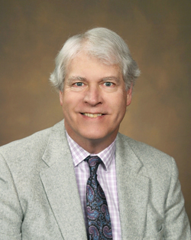
Mark W. Hendrickson provides a Biblical Analysis of Social Justice: [Biblical] Justice not only means that nobody is to be picked on because he is poor or favored because he is rich, but that (contrary to the doctrine of “social justice”) nobody is to be picked on because he is rich or favored because he is poor.

Slide 196
The fundamental error of today’s ‘social justice’ practitioners is their hostility to economic inequality, per se. Social justice theory fails to distinguish between economic disparities that result from unjust deeds and those that are part of the natural order of things. All Christians oppose unjust deeds… [but] it isn’t necessarily unjust for some people to be richer than others.

Slide 197
God made us different from each other. We are unequal in aptitude, talent, skill, work ethic, priorities, etc. Inevitably, these differences result in some individuals producing and earning far more wealth than others. To the extent that those in the ‘social justice’ crowd obsess about eliminating economic inequality, they are at war with the nature of the Creator’s creation.

Slide 198
The Bible doesn’t condemn economic inequality. You can’t read Proverbs without seeing that some people are poor due to their own vices. There is nothing unjust about people reaping what they sow, whether wealth or poverty. Jesus himself didn’t condemn economic inequality.

Slide 199
Yes, he repeatedly warned about the snares of material wealth; he exploded the comfortable conventionality of the Pharisaical tendency to regard prosperity as a badge of honor and superiority; he commanded compassion toward the poor and suffering.

Slide 200
But he also told his disciples, “you have the poor always with you” (Matthew 26:11), and in the parable of the talents (Matthew 25:24-30) he condemned the failure to productively use one’s God-given talents—whether many or few, exceptional or ordinary—by having a lord take money from the one who had the least and give it to him who had the most, thereby increasing economic inequality.

Slide 201
The Lord’s mission was to redeem us from sin, not to redistribute our property or impose an economic equality on us. In fact, Jesus explicitly declined to undermine property rights or preach economic equality when he told the man who wanted Jesus to tell his brother to share an inheritance with him, “Man, who made me a judge or divider over you” (Luke 12:14).

Slide 202
Karl Marx proclaimed: “The idea of God is the keynote of a perverted civilization. It must be destroyed.”

Slide 203
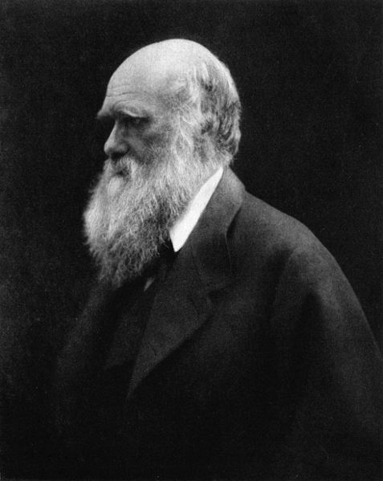
Charles Darwin (1809-1882)

Slide 204
While Darwin’s theory of evolution has been readily accepted by all mainstream liberal churches it also has made great inroads into evangelical churches and colleges.

Slide 205
Nazarene churches have historically been rather evangelical yet their colleges (Point Loma Nazarene University, Eastern Nazarene College, etc.) reek with Darwinism.

Slide 206
Point Loma’s biology professor, Darrel R. Falk, is also the head of BioLogos, a theistic evolution organization which brings its evolution message to hundreds of evangelical churches.

Slide 207
Christianity Today reported on March 30, 2012 that “evangelical evolutionists meet in New York.” The article explains:

Slide 208
Attending were such luminaries as N.T. Wright, Alister McGrath, John Ortberg, Tim Keller, Scot McKnight, Os Guinness, Joel Hunter, and Andy Crouch…This year’s program centered on concerns for the church—especially for young people who feel torn between science and the Bible.

Slide 209
Tim Keller is Quoted in The Article as Saying: “To develop a BioLogos narrative is the job of pastors.”

Slide 210
Really? So the job of pastors is to undermine the authority of Scripture and dilute the purpose and need of the death, burial, and resurrection of Jesus Christ due to original sin? This is what BioLogos is doing when they deny the biblical and historical persons of Adam and Eve and the original sin that entered into the world through the Fall.

Slide 211
John Upchurch with Answers in Genesis wrote an article entitled “The Danger of BioLogos” in which he makes the case that BioLogos attacks the gospel:

Slide 212
In their effort to reconcile evolution with the Bible, proponents of theistic evolution also wipe away the cosmic impact of the Curse and of Christ’s full redemptive work. Romans 8:22 makes it clear that the whole creation groans as a result of Adam’s sin. Acts 3:21 and Colossians 1:15–20 teach that when Christ, the Creator of all things, comes again He will restore all things.

Slide 213
At that time, the Curse of Genesis 3 will be removed, and a glorious new heavens and earth will exist (Revelation 22:3).

Slide 214
The denial of a “first couple” similarly attacks the gospel. “Jesus and the apostle Paul clearly consider Adam and Eve to be historical,” explains theologian Cal Beisner. “Paul makes our whole understanding of the relationship between the redeemed and Christ contingent on Adam’s being a historical individual just as Christ is (Romans 5:12–19; 1 Corinthians 15:22, 15:46–49).

Slide 215
Take away Adam as a historical person, and the whole understanding of the federal (covenantal) relationship between Christ and believers collapses—and with it the gospel of justification by grace alone through faith alone in Christ alone because of the federal (covenantal) imputation of His righteousness to believers.”

Slide 216
The John Templeton Foundation Provided Funds to Launch BioLogos.

Slide 217
The Website for the Foundation Explains its Purpose: These grants support the launch of the BioLogos Foundation with the creation of a website and a series of workshops on the compatibility of theism and evolutionary science.

Slide 218
The Website for the Foundation Explains its Purpose: The website will serve as a forum for Francis Collins and other expert consultants to address common questions about the relationship between faith and science. The invitation-only workshops will bring scientists and evangelical leaders together to seek a theology more accepting of science, specifically evolutionary biology.

Slide 219
John Templeton Was a Promoter of Pagan Spirituality Who Wanted to Establish a World Religion: “about God that doesn’t rely on ancient revelations or scripture.”

Slide 220
Lesson 2: Religion, the Foundation for the New World Order

Slide 221
The Bible is clear, that a one-world religion will be established—and it’s not a good thing. Second Thessalonians 2:3-4 Makes it Very Clear:

Slide 222
Let no one deceive you by any means; for that Day will not come unless the falling away comes first, and the man of sin is revealed, the son of perdition, who opposes and exalts himself above all that is called God or that is worshiped, so that he sits as God in the temple of God, showing himself that he is God.

Slide 223
Revelation 13:8 Declares: “All who dwell on the earth will worship him, whose names have not been written in the Book of Life of the Lamb slain from the foundation of the world”

Slide 224
The Bible is clear that one one-world economy will be established. Revelation 13:16-17 prophesies:

Slide 225
“He causes all, both small and great, rich and poor, free and slave, to receive a mark on their right hand or on their foreheads, and that no one may buy or sell except one beast, or the number of his name.”

Slide 226
We also see in the Scriptures there will be a one-world government, as noted in Revelation 13:2-4:

Slide 227
The dragon gave him his power, his throne, and great authority. And I saw one of his heads as if it had been mortally wounded, and his deadly wound was healed.

Slide 228
Revelation 13:7: It was granted to him to make war with the saints and to overcome them. And authority was given him over every tribe, tongue, and nation.

Slide 229
Revelation 17:12-13: The ten horns which you saw are ten kings who have received no kingdom as yet, but they receive authority for one hour as kings with the beast.

Slide 230
The one-world religion will be the vehicle that brings about the one-world economy and one-world government.

Slide 231
When a sovereign currency is dissolved into a “group currency,” national sovereignty is seriously undermined.

Slide 232
Many believe Fabian socialism or communitarianism will be at the heart of the new way of things.

Slide 233
The Fabians know that cloaking their actions in religiosity will accelerate the acceptance of their ends among many people.

Slide 234
Communitarianism and Fabian socialism are twin sisters, but we generally do not call communitarians by the label of Fabian socialist because most have never belonged to the Fabian Socialist Society.

Slide 235
But make no mistake, communitarians and Fabian socialists are united in the common goal of merging capitalism with socialism, promoting social justice, and establishing what they call a new world order.

Slide 236
Fabian socialism started in London in 1883. Fabians pursue socialism by evolution, not revolution (as compared to communists who advocate revolution).

Slide 237
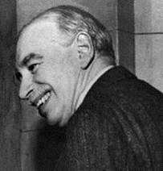
One Fabian socialist who has greatly damaged America is John Maynard Keynes, from whom we get Keynesian economics.

Slide 238
Keynes is likely the world’s best-known economist. Yet, the values represented by Keynesian economics are contrary to much of what makes for healthy financial living for individuals or nations: love of debt and hatred of savings.

Slide 239
Keynes believed that during an economic downturn or recession, government should borrow or inflate the currency and dump large amounts of cash into the economy by being the primary source of spending and employment. The end results are inflation, the devaluation of currency, and debt.

Slide 240
The true goal of Fabian socialism is not merely national socialism but globalism.

Slide 241
Fabianism dovetails well with corporate fascism, the merging of big government and big business.

Slide 242
Marist John Strachey explains Keynesian economics this way: The positive part of Keynes’ work was a demand that capitalism should now be regulated and controlled by a central authority….The principal instruments of its policy should be variations in the rate of interest, budgetary deficits and surpluses, public works and a redistribution of personal incomes in equalitarian direction.

Slide 243
This positive side of Keynes’ work requires an authority to do the regulating, and that authority can be, in contemporary conditions, nothing else but the government of a nation state.

Slide 244
John Maynard Keynes Himself: …a continuous process of inflation, governments can confiscate, secretly and unobserved, an important part of the wealth of their citizens. By this method, they not only confiscate, but confiscate arbitrarily: and while the process impoverishes many, it actually enriches some. The process engages all of the hidden forces of economic law on the side of destruction, and does it in a manner that not one man in a million can diagnose.

Slide 245
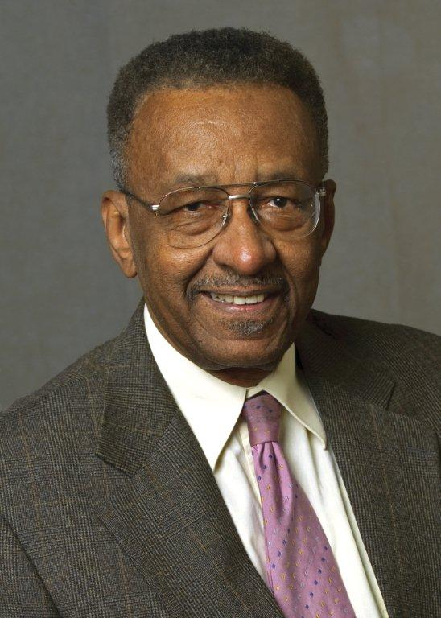
According to Economics Writer Walter Williams: The justification for the Federal Reserve Act of 1913 was to prevent bank failure and maintain price stability. Simple before and after analysis demonstrates that the Federal Reserve Bank has been a failure.

Slide 246
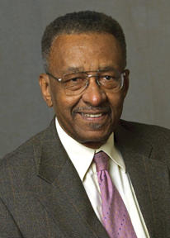
In the century before the Federal Reserve Act, wholesale prices fell by 6 percent; in the century after they rose by 1,300 percent. Maximum bank failures in one year before 1913 were 496 and afterward, 4,400. During the 1930s, inept money supply management by the Federal Reserve Bank was partially responsible for both the depth and duration of the Great Depression.

Slide 247
Keynesian economics is unbiblical for many reasons, but even a quick reading of the Ten Commandments reveals two. The commandments against coveting and stealing are broken when the government covets what you own and seeks to steal it from you through inflation.

Slide 248
Further, in Deuteronomy 25:13-16, God declares His hatred of unjust weights and scales used to cheat people. Our government and the Federal Reserve use the “unjust weights and scales” of monetization (printing money) of our national debt to steal from Americans for the government’s self-serving financial gain and harvesting of power.

Slide 249
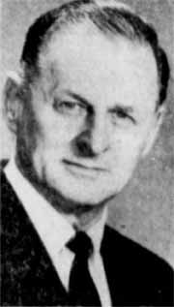
Zygmund Dobbs, who conducted research for the book Keynes at Harvard, describes Keynes and his socialist buddies this way:

Slide 250
Singing the Red Flag, the highborn sons of the British upper-class lay on the carpeted floor spinning out socialist schemes in homosexual intermissions….The attitude in such gatherings was anti-establishmentarian. To them the older generation was horribly out of date, even superfluous. The capitalist system was declared obsolete and revolution was proclaimed as the only solution.

Slide 251
Christianity was pronounced an enemy force, and the worst sort of depravities were eulogized as “that love which passes all Christian understanding.” Chief of this ring of homosexual revolutionaries was John Maynard Keynes….Keynes was characterized by his male sweetheart, Lytton Strachey, as “a liberal and a sodomite, an atheist and a statistician.” His particular depravity was the sexual abuse of little boys.

Slide 252
Notice that Christianity was pronounced an “enemy force.” Fabian socialists hate Christianity. But that does not mean they will not call themselves Christians or be friendly to Christians as they build the religious Trojan horse.

Slide 253
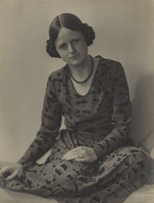
Joan Robinson, a Marxist economist who worked with Keynes, declared that: “the differences between Marx and Keynes are only verbal.”

Slide 254
Many believe that elected officials at the state and federal level are Fabian socialists or communitarians that are committed to a social revolution in America by deliberately creating an environment in which chaos and crisis can flourish for the purpose of bigger government—and moving us toward globalism.

Slide 255
The end game for a Fabian socialist is global governance. So, whether you call it Fabian socialism or communitarianism; whether you call it internationalism or statism—whatever you want to call it—they’re all working together.

Slide 256
The worldviews vary, but all are headed toward the same goal of global governance, a one-world economic system and a one-world government.

Slide 257
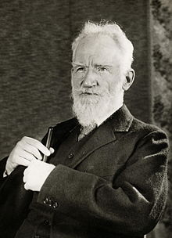
George Bernard Shaw was a Famous Fabian Who Observed: I as a socialist have had to preach as much as anyone the enormous power of the environment. We can change it. We must change it. There’s absolutely no other sense in life than the task of changing it. What is the use of writing plays? What is the use of writing anything if there’s not a will which finally molds chaos itself into a race of gods.

Slide 258
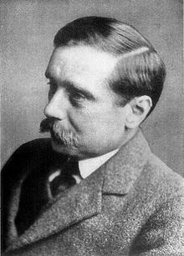
In his book, The Open Conspiracy: Blueprints for a World Revolution, H. G. Wells, another, declares: This is my religion, the way of salvation, the political work of the Open Conspiracy must weaken, efface, incorporate and supersede existing governments. The character of the Open Conspiracy will now be plainly displayed. It will be a world religion.

Slide 259
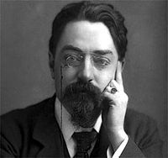
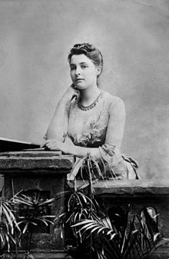
In 1895, Fabian Society members Sidney Webb, Beatrice Webb, and George Bernard Shaw founded the London School of Economics.

Slide 260
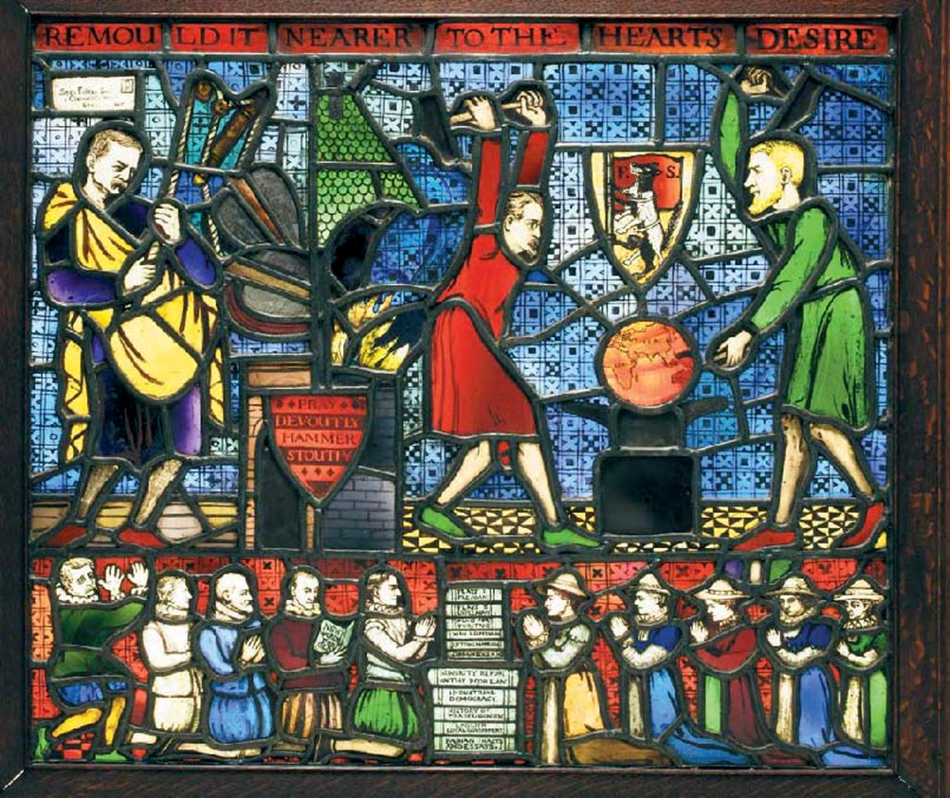
The Fabian Window

Slide 261
The Fabian stained glass window was created and designed by George Bernard Shaw in 1910.

Slide 262
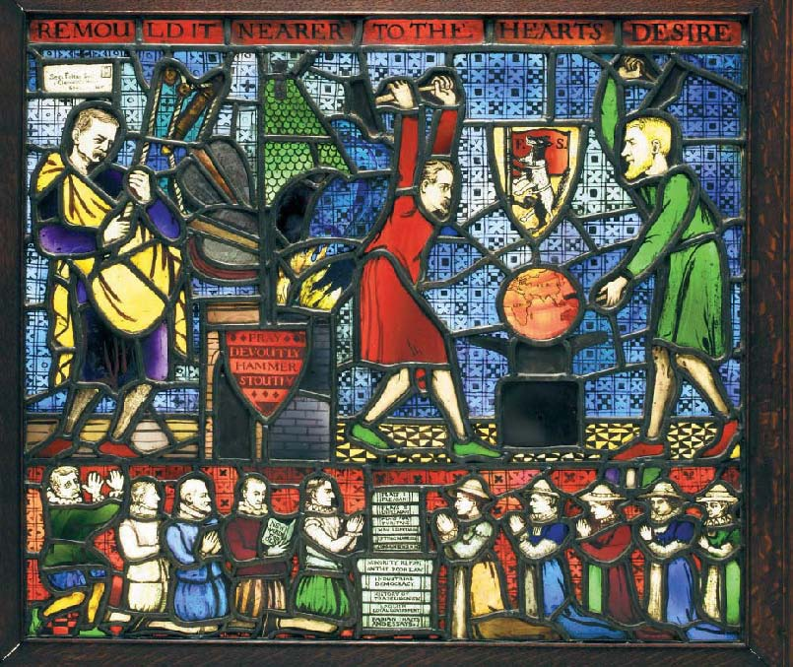

Slide 264
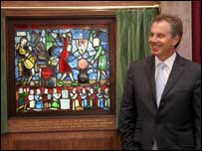
Tony Blair unveils Shaw's design (pic by Maria Moore/LSE)

Slide 265
Crisis Manufacturing

Slide 266
Globalist James MacGregor Burns in His 1984 book, The Power to Lead Writes: Let us face reality. The framers [of the Constitution] have simply been too shrewd for us. They have outwitted us. They designed separated institutions that cannot be unified by mechanical linkages, frail bridges, tinkering. If we are to “turn the founders upside down” we must directly confront the constitutional structure they erected.

Slide 267
Others might press for major constitutional restructuring but I doubt that Americans under normal conditions could agree on the package of radical and “alien” constitutional changes that would be required. They would do so, I think, only during and following a stupendous national crisis and political failure.

Slide 268
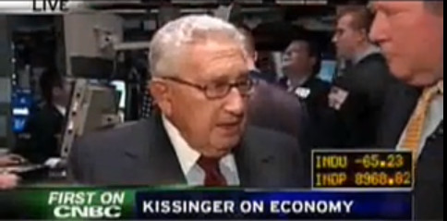
Speaking of President-elect Obama, Kissinger in 2009 Said: “His task will be to develop an overall strategy for America in this period when, really, a new world order can be created. It’s a great opportunity, it isn’t just a crisis.”

Slide 269
Barack Obama’s White House Chief of Staff, Rahm Emanuel, Told Business Leaders in a November 2008 That The Financial Crisis Presents: “an opportunity to do things you could not do before…You never want a serious crisis to go to waste.”

Slide 270
On January 1, 2009, Gorbachev wrote a column in the International Herald Tribune in which he wrote: Attribution: RIA Novosti archive, image # / CC-BY-SA 3.0

Slide 271
“The G-20 summit meeting in Washington foreshadowed a new format of global leadership, bringing together the countries responsible for the future of the world economy. And more than just the economy is at stake… Attribution: RIA Novosti archive, image # / CC-BY-SA 3.0

Slide 272
The economic and political balance in the world has changed. It is now a given that a world with a single power center, in any shape or guise, is no longer possible. The global challenge of a financial and economic tsunami can only be met by working together. Attribution: RIA Novosti archive, image # / CC-BY-SA 3.0

Slide 273
A new concept is emerging for addressing the crisis at the national and international levels. If current ideas for reforming the world’s financial and economic institutions are consistently implemented, that would suggest we are finally beginning to understand the importance of global governance.”

Slide 274
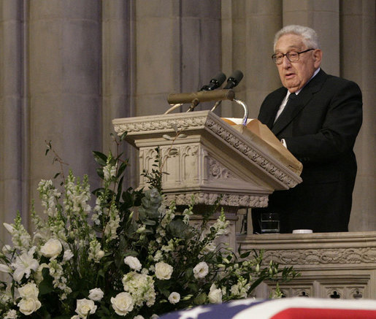
On January 12, 2009, Henry Kissinger Published an Article in the International Herald Tribune Entitled “A Chance for New World Order” in Which He Declared:

Slide 275
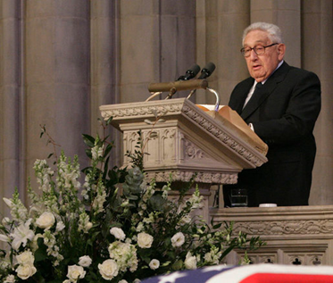
“As the new U.S. administration prepares to take office amid grave financial and international crises, it may seem counterintuitive to argue that the very unsettled nature of the international system generates a unique opportunity for creative diplomacy….

Slide 276
An international order can be permanent only if its participants have a share not only in building but also in securing it. In this manner, America and its potential partners have a unique opportunity to transform a moment of crisis into a vision of hope.”

Slide 277
Dick Morris’s April 7, 2009 article, “European Socialism to Run Our Financial System,” explains: On April 2, 2009, the work of July 4, 1776 was nullified at the meeting of the G-20 in London.

Slide 278
Dick Morris: “The joint communiqué essentially announces a global economic union with uniform regulations and bylaws for all nations, including the United States. Henceforth, our SEC, Commodity Futures Trading Commission, Federal Reserve Board and other regulators will have to march to the beat of drums pounded by the Financial Stability Board (FSB), a body of central bankers from each of the G-20 states and the European Union.

Slide 279
Dick Morris: The mandate conferred on the FSB is remarkable for its scope and open-endedness. It is to set a “framework of internationally agreed high standards that a global financial system requires.”

Slide 280
Dick Morris: Now we may no longer look to presidential appointees, confirmed by the Senate, to make policy for our economy. These decisions will be made internationally. And Europe will dominate them. The FSF [Financial Stability Forum and precursor to the FSB] and, presumably, the FSB is now composed of the central bankers of Australia, Canada, France, Germany, Hong Kong, Italy, Japan,

Slide 281
Dick Morris: Netherlands, Singapore, Switzerland, the United Kingdom, and the United States plus representatives of the World Bank, the European Union, the IMF, and the Organization for Economic Co-operation and Development (OECD).

Slide 282
Dick Morris: The Europeans have been trying to get their hands on our financial system for decades. It is essential to them that they rein in American free enterprise so that their socialist heaven will not be polluted by vices such as the profit motive.

Slide 283
In the December 9, 2008 Financial Times, Gideon Rachman shared his concern in “And Now for World Government”:

Slide 284
Gideon Rachman: “I have never believed that there is a secret United Nations plot to take over the US. I have never seen black helicopters hovering in the sky above Montana.

Slide 285
Gideon Rachman: But, for the first time in my life, I think the formation of some sort of world government is plausible.

Slide 286
Gideon Rachman: A “world government” would involve much more than co-operation between nations. It would be an entity with state-like characteristics, backed by a body of laws. The European Union has already set up a continental government for 27 countries, which could be a model. The EU has a supreme court, a currency, thousands of pages of law, a large civil service and the ability to deploy military force.”

Slide 287
On July 10, 2009, Bloomberg announced in “Medvedev Shows Off Sample Coin of New ‘World Currency’ at G-8”:

Slide 288
Bloomberg News:

Slide 289
Bloomberg: Russian President Dmitry Medvedev illustrated his call for a supranational currency to replace the dollar by pulling from his pocket a sample coin of a “united future world currency.”

Slide 290
Bloomberg: “Here it is,” Medvedev told reporters today in L’Aquila, Italy, after a summit of the Group of Eight nations. “You can see it and touch it.” The coin, which bears the words “unity in diversity,” was minted in Belgium and presented to the heads of G-8 delegations, Medvedev said.

Slide 291
Bloomberg: The question of a supranational currency “concerns everyone now, even the mints,” Medvedev said. The test coin “means they’re getting ready. I think it’s a good sign that we understand how interdependent we are.”

Slide 292
Wolves in Sheep’s Clothing

Slide 293
In Matthew 7:15-16 Jesus Warned: “Beware of false prophets, who come to you in sheep’s clothing, but inwardly they are ravenous wolves. You will know them by their fruits.”

Slide 294
2 John 9-11 Declares: Whoever transgresses and does not abide in the doctrine of Christ does not have God. He who abides in the doctrine of Christ has both the Father and the Son. If anyone comes to you and does not bring this doctrine, do not receive him into your house nor greet him; for he who greets him shares in his evil deeds.

Slide 295
Globalist Building The Kingdom of Satan

Slide 296
One of America’s most influential families, the Rockefellers, was heavily involved in founding the Council on Foreign Relations.

Slide 297
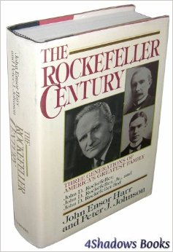
John Ensor Harr and Peter J. Johnson Document in Their Book on the Rockefellers that John D. Rockefeller, Jr. Was: [a] committed internationalist, he financially supported programs of the League of Nations and crucially funded the formation and ongoing expenses of the Council on Foreign Relations and its initial headquarters building, in New York in 1921.

Slide 298
The United Nations was birthed out of the Council on Foreign Relations on October 24, 1945, and the Rockefellers donated the land in New York City on which the United Nations headquarters was built.

Slide 299
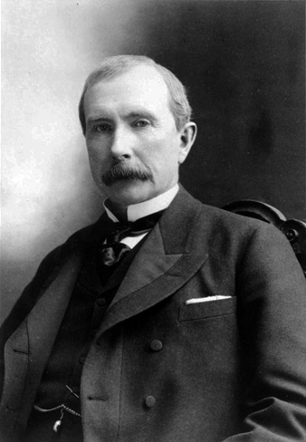
John D. Rockefeller Was also a Strong Promoter and Supporter of Ecumenicalism. John D. Rockefeller Once Declared: Would that I had the power to bring to your minds the vision as it unfolds before me! I see all denominational emphasis set aside….

Slide 300
I see the church molding the thought of the world as it has never done before, leading in all great movements as it should. I see it literally establishing the Kingdom of God on earth.

Slide 301
In His memoirs, David Rockefeller Admitted to the Goals of His Family, Which Many Have Been Alleging for Years: “Some even believe we [the Rockefellers] are part of a secret cabal working against the best interests of the United States, characterizing my family and me as “internationalists”

Slide 302
and of conspiring with others around the world to build a more integrated global political and economic structure—one world, if you will. If that’s the charge, I stand guilty, and I am proud of it.”

Slide 303
In 1959, the Rockefeller Brothers Fund Report Entitled “The Mid-Century Challenge to U.S. Foreign Policy,” Outlined: “the task of helping shape a new world order in all its dimensions—spiritual, economic, political, social.”

Slide 304
Many who call themselves Christians are part of Dominion Theology which is the belief that they are to build and usher in the Kingdom of God on earth through political, social, and religious domination.

Slide 305
Jesus made it clear in John 18:36 That Dominion Theology is not Biblical When He Declared: “My kingdom is not of this world. If My kingdom were of this world, My servants would fight, so that I should not be delivered to the Jews; but now My kingdom is not from here.”

Slide 306
Our call is not to physically build God’s kingdom here on earth now. We are to be involved in building His kingdom in the spiritual realm as we preach the Gospel, which brings people to salvation through Jesus Christ alone.

Slide 307
Socialism by Another Name

Slide 308
The “social justice” is merely socialism or redistribution of wealth. The term has been used by communists for years, and now it is being used by religious leaders.

Slide 309
When social justice comes into the Church it is called the social gospel.

Slide 310
Dr. Walter Rauschenbusch is called the father of the social gospel.

Slide 311
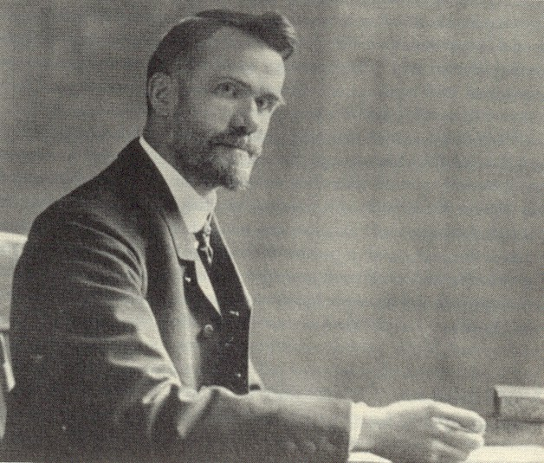
Dr. Walter Rauschenbusch 1861-1918

Slide 312
A member of the Fabian Socialist Society, Rauschenbusch taught at Rochester Theological Seminary. His goal was to indoctrinate seminary students in socialism, global governance, the social gospel, and Fabian socialism, and then send them into the churches.

Slide 313
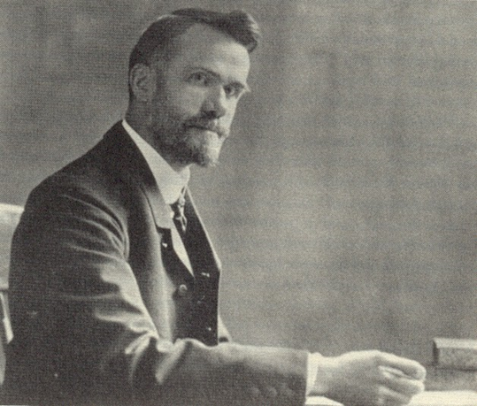
Dr. Walter Rauschenbusch: “Father of the Social Gospel” The only power that can make socialism succeed, if it is established, is religion. It cannot work in an irreligious country.

Slide 314
Rauschenbusch spoke of Jesus: “not as one who would come to save sinners from their sins but as one who had a ‘social passion’ for society.”

Slide 315
With the financial support of the Rockefellers, Rauschenbusch and his Fabian colleague, Rev. Harry F. Ward (also known as the “Red Dean” for his communist beliefs), started the Federal Council of Churches, which later became the National Council of Churches.

Slide 316
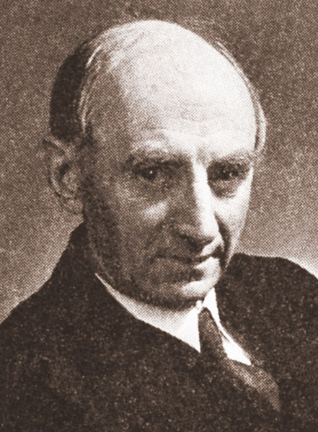
According to a Publication of the Federal Council of Churches, Ward Sought to Produce: “a changed attitude on the part of many church members concerning the purpose and function both of the Church and Christianity.”

Slide 317
Why would they want to change the purpose of the Church? They wanted to move it away from preaching the Gospel to using it as a vehicle for bringing about global governance, social justice, and the ideas that we see communitarians and other social justice/social gospel proponents promoting.

Slide 318
Author Edgar Bundy explains in Collectivism in the Churches that: ...we have seen how Dr. Walter Rauschenbusch... and the leaders of the social-action movements in the churches decided to do away with Christian individualism and turn to outright collectivism, using the church as their instrument....

Slide 319
Religion was only a means toward achieving socialism. And, like all other false prophets who have infiltrated religion through the centuries, [Rauschenbusch] used a “front” or disguise. This disguise, as we have seen, was “'The Kingdom of God.”

Slide 320
The Kingdom was not pictured as a spiritual society into which men and women had to be born as individuals through a personal relationship with Jesus Christ as Savior, but as a collectivist society which would be brought about by... eradication of poverty, redistribution of wealth... and “economic justice.”

Slide 321
Take note of this incredible testimony before the Committee on Un-American Activities of the U.S. House of Representatives in July, 1953. Robert Kunzig, chief counsel for the committee, asked Manning Johnson, a former top member of the Communist Party, a series of questions:

Slide 322
KUNZIG: ...the name Harry Ward has appeared in so many of these various organizations and groups. It seems as if there is almost an interlacing tie-up... through various sects and denominations. Have you any comment to make on this situation?

Slide 323
JOHNSON: Yes, I have. Dr. Harry F. Ward, for many years, has been the chief architect for Communist infiltration and subversion in the religious field.

Slide 324
KUNZIG: ...could you give us a summary of the overall manner in which the Communists have attempted to infiltrate and poison the religious organizations of America wherever possible?

Slide 325
JOHNSON: Once the tactic of infiltrating religious organizations was set by the Kremlin, the actual mechanics of implementing the “new line” was a question of following the... church movement in Russia, where the Communists discovered that the destruction of religion could proceed much faster through infiltration of the church by Communist agents operating within the church itself…

Slide 326
JOHNSON: the infiltration tactic in this country would have to adapt itself to American conditions.... In the earliest stages it was determined that with only small forces available it would be necessary to concentrate Communist agents in the seminaries and divinity schools.

Slide 327
JOHNSON: The practical conclusion drawn by the Red leaders was that these institutions would make it possible for a small Communist minority to influence the ideology of future clergymen....The idea was to divert the emphasis of clerical thinking from the spiritual to the material....

Slide 328
JOHNSON: Instead of emphasis towards the spiritual and matters of the soul, the new and heavy emphasis was to deal with those matters which, in the main, led toward the Communist program of “immediate demands”….

Slide 329
Manning Johnson explained that religion was the cover for an overall communist operation:

Slide 330
Johnson: The plan was to make the seminaries the neck of a funnel through which thousands of potential clergymen would issue forth, carrying with them, in varying degrees, an ideology and slant which would aid in neutralizing the anti-Communist character of the church and also to use the clergy to spearhead important Communist projects....

Slide 331
Johnson: This policy was successful beyond even Communist expectations. The combination of Communist clergymen, clergymen with a pro-Communist ideology, plus thousands of clergymen who were sold the principle of considering Communist causes as progressive... furnished the Soviet apparatus with a machine which was used as a religious cover for the overall Communist operation.

Slide 332
Benjamin Gitlow, a Communist Party USA founder who turned against Communism, wrote and spoke against Communism until his death in 1965. He, too, testified before the committee:

Slide 333
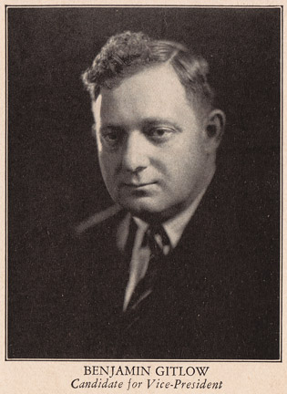

Slide 334
KUNZIG: What kind of an organization was the Methodist Federation for Social Action, and how did it differ from a Communist-front organization?

Slide 335
GITLOW: The Methodist Federation for Social Action, originally called the Methodist Federation for Social Service, was first organized by a group of Socialist, Marxist clergymen of the Methodist church headed by Dr. Harry F. Ward.

Slide 336
Dr. Ward was the organizer, for almost a lifetime its secretary and actual leader. He at all times set its ideological and political pattern. Its objective was to transform the Methodist Church and Christianity into an instrument for the achievement of socialism. It was established in 1907, 12 years before the organization of the Communist Party in the United States in 1919

Slide 337
Committed Christians must warn the Church of the wolves in sheep’s clothing, just as the Fabian socialists’ window depicted.

Slide 338
Jude 3-4: I found it necessary to write to you, exhorting you to contend earnestly for the faith, which was once for all delivered to the saints, for certain men have crept in unnoticed, who long ago were marked out for this condemnation, ungodly men who turned the grace of our God into lewdness and deny the only Lord God and our Lord, Jesus Christ.

Slide 339
Second Peter 2:1-2: “there will be false teachers among you, who will secretly bring in destructive heresies, even denying the Lord who bought them, and bring on themselves swift destruction. And many will follow their destructive ways.”

Slide 340
In 1979, Goldwater wrote the book With No Apologies in which explained that the globalists plan: “represents a skillful, coordinated effort to seize control and consolidate the four centers of power—political, monetary, intellectual, and ecclesiastical.”

Slide 341
First Corinthians 11:18-19 Explains Divisions Over Truth Are Actually Necessary: For first of all, when you come together as a church, I hear that there are divisions among you, and in part I believe it. For there must also be factions among you, that those who are approved may be recognized among you.

Slide 342
Lesson 3 Dangers of the New Apostolic Reformation and Dominion Theology

Slide 343
Dominion theology is the belief that God gave Adam and Eve a sort of legal authority over the whole earth.

Slide 344
The Idea for Dominion Theology Derives from Genesis 1:26, 28, Which Reads: Then God said, “Let Us make man in Our image, according to Our likeness; let them have dominion over the fish of the sea, over the birds of the air, and over the cattle, over all the earth and over every creeping thing that creeps on the earth.”…

Slide 345
Then God blessed them, and God said to them, “Be fruitful and multiply; fill the earth and subdue it; have dominion over the fish of the sea, over the birds of the air, and over every living thing that moves on the earth.”

Slide 346
All we really see in this passage is God giving Adam administrative rule over the animals and plants on the earth that God created. Any transfer of legal authority is not implied. The word dominion in this passage is “radah,” which literally means to “tread down” or “master.”

Slide 347
To say that this passage gave Adam legal authority over the whole earth contradicts passages in the Bible that paint a clear picture that God created man to be the steward of God’s earth. Scripture does not in any way imply that there was some legal transfer of authority or ownership of the earth from God to man. In the garden, man reported to God and limits were set.

Slide 348
Legal authority implies that God has delegated His authority to man while stewardship suggests that God is still the Master and Owner of the world of which we have been made the managers, a significant distinction.

Slide 349
Al Dager in Vengeance Is Ours: The Church in Dominion, outlines the three beliefs that characterize this approach: “Dominion theology is predicated upon three basic beliefs: 1) Satan usurped man’s dominion over the earth through the temptation of Adam and Eve; 2) The Church is God’s instrument to take dominion back from Satan; 3) Jesus cannot or will not return until the Church has taken dominion by gaining control of the earth’s governmental and social institutions.”

Slide 350
One of the fastest growing movements—and key promoter of dominion theology—inside evangelicalism is the New Apostolic Reformation, also called the NAR.

Slide 351
The New Apostolic Reformation is an outgrowth of the Latter Rain Movement, the Word of Faith movement that includes the prosperity gospel (also known as “Name It and Claim It”).

Slide 352
The Church has been warned about this heretical movement. In 1949, for example, the General Council of the Assemblies of God USA issued the following declaration when it kicked the Latter Rain Movement out of its denomination:

Slide 353
RESOLVED, That we disapprove of those extreme teachings and practices which, being unfounded Scripturally, serve only to break fellowship of like precious faith and tend to confusion and division among the members of the Body of Christ, and be it hereby known that this 23rd General Council disapproves of the so-called, “New Order of the Latter Rain,” to wit:

Slide 354
1. The overemphasis relative to imparting, identifying, bestowing or confirming gifts by the laying on of hands and prophesy. 2. The erroneous teaching that the church is built upon the foundation of present day apostles and prophets.

Slide 355
3. The extreme teaching as advocated by the “new order” regarding the confession of sin to man and deliverance as practiced, which claims prerogatives to human agency which belong only to Christ. 4. The erroneous teaching concerning the impartation of the gift of languages as special equipment for missionary service.

Slide 356
5. The extreme and unscriptural practice imparting or imposing personal leading by the means of utterance. 6. Such other wrestings and distortions of Scripture, interpretations which are in opposition to teachings and practices generally accepted among us.

Slide 357
Today, offspring of the Latter Rain movement, the New Apostolic Reformation (NAR), has become mainstream within many church denominations and is eaglerly embraced even by non-pentecostal or non-charismatic “Christians” and leaders of the New Religious Right.

Slide 358
As you learn what I have to say about the NAR, please do not confuse the New Apostolic Reformation with Reconstructionists that also embrace dominion theology. Many Reconstructionists would join me in objecting to the heretical theology of the New Apostolic Reformation.

Slide 359
(1) The New Apostolic Reformation believes the primary purpose of the Church is to take back dominion of the earth from Satan and to build and establish a physical Kingdom of God on earth.

Slide 360
Adherents to dominion theology and the New Apostolic Reformation believe they must establish the Kingdom of God on earth before Christ can return.

Slide 361
Dominion Theology is Completely Unbiblical thinking, as Jesus Himself Declares in John 18:36: “My kingdom is not of this world. If My kingdom were of this world, My servants would fight, so that I should not be delivered to the Jews; but now My kingdom is not from here.”

Slide 362
Christians are to build God’s Kingdom, but that takes place in the spiritual realm as we preach the Gospel and as people are added spiritually to the Kingdom of God. We are not called to build a physical kingdom here on earth.

Slide 363
C. Peter Wagner, who originally came to prominence for his studies of church growth, is one of the leaders and founders of the New Apostolic Reformation.

Slide 364
Wagner’s Influence in Developing The NAR is Even Documented by National Public Radio: “The international ‘apostolic and prophetic’ movement has been dubbed by its leading American architect, C. Peter Wagner, as the New Apostolic Reformation (NAR).”

Slide 365
In a letter Posted Online Wagner Declared: Our theological bedrock is what has been known as Dominion Theology. This means that our divine mandate is to do whatever is necessary, by the power of the Holy Spirit, to retake the dominion of God’s creation which Adam forfeited to Satan in the Garden of Eden.

Slide 366
Reports from the Arise Prophetic Conference in October 2004 indicate Wagner declared there that the church needs to form a government in order to overthrow the government of Satan:

Slide 367
C. Peter Wagner: “See, the problem is, is that Satan has had too much of his way in our society because he has a government! And the only way to overthrow a government is with a government. It won’t happen otherwise.

Slide 368
C. Peter Wagner: So therefore the government of the church has to get into place in the extended church just like we do have it very well in place; we haven’t reached our goal yet, but it’s very well established in the nuclear church…

Slide 369
C. Peter Wagner: These apostles in the workplace are the ones that are going to come into the picture and with them we’ll be opening these gates; without them we can have all the prayer meetings we want, all the marches for Jesus we want, all the prayer walking we want, the gates aren’t going to be opened.

Slide 370
C. Peter Wagner: Because it takes a government to overthrow a government. Gate number one, letter A, the gate of social transformation, the gate of social transformation.... This gate will be opened when we understand about the church in the workplace, that the church has a government, that it takes a government to overthrow a government, and when we understand this, if we renew our minds, if we embrace this paradigm shift,

Slide 371
C. Peter Wagner: if we see, if we hear what the spirit is saying to the churches, if we recognize ministry in the extended church and government in the extended church, the revival we’ve been praying for is just around the corner. We will see it....

Slide 372
C. Peter Wagner: And now I pray for every individual here, before you, who is in the workplace, who tomorrow and in the days to come will be going out to their ministries in the workplace, and I impart to them an anointing, I impart to them an anointing for not seeing a job, but seeing a ministry in the workplace.

Slide 373
C. Peter Wagner: And I impart an anointing to them and to this whole community to recognize and raise up apostles who will set the church in the workplace in order so that our cities, our communities, our states, and our nations will be transformed for Your glory, in Jesus’ name.”

Slide 374
How They Plan to Take Dominion In order to take dominion back from Satan, the NAR and Word of Faith teach that Satan must be bound. Thus, the NAR and Word of Faith run around the globe holding prayer and fasting services in their attempts to bind Satan and take dominion neighborhood by neighborhood, town by town, city by city, state by state, and nation by nation.

Slide 375
To justify this “binding of Satan,” the NAR and Word of Faith often use Matthew 16:19 and 18:18. They use them, however, out of context to maintain their teaching that Jesus’ words have anything to do with people “binding Satan.”

Slide 376
Matthew 16:19: “I will give you the keys of the kingdom of heaven; whatever you bind on earth will be bound in heaven, and whatever you loose on earth will be loosed in heaven.” Matthew 18:18: Truly I tell you, whatever you bind on earth will be bound in heaven, and whatever you loose on earth will be loosed in heaven.

Slide 377
Matthew 16:19 and 18:18 have nothing to do with binding Satan but, rather, are talking about church discipline.

Slide 378
The verses teach that if church leadership declares someone is bound by sin and their declaration is in accord with what the Bible describes as sin, then heaven agrees with that assessment. If the individual that is bound in sin repents as described in the Word of God, then heaven agrees with that as well.

Slide 379
In Jude 9 we read where Michael the archangel did not attempt to “bind” Satan nor engage him in an argument: Yet Michael the archangel, in contending with the devil, when he disputed about the body of Moses, dared not bring against him a reviling accusation, but said, “The Lord rebuke you!”

Slide 380
Our rightful response to Satan is found in James 4:7-8: Therefore submit to God. Resist the devil and he will flee from you. Draw near to God and He will draw near to you. Cleanse your hands, you sinners; and purify your hearts, you double-minded.

Slide 381
A better translation of “submit to God” is to be “lined up under” His authority. God is our defender and protect when we follow His will and His authority.

Slide 382
A better translation of “resist” is to “take your stand.” Notice, however, that we only take our stand after lining up under God. Once we have lined up, living in obedience to God and His Word, then we can take our stand knowing that greater is He that is in me than he that is in the world.

Slide 383
To “draw near to God” is to take seriously our relationship with Him through prayer and the study of His Word.

Slide 384
There is protection from Satan when we are under God’s authority and living in His will.

Slide 385
2 Peter 2:9-12 tells us false teachers who rail against demons are foolishly doing what even the angels, who are more powerful than demons, will not do:

Slide 386
[T]hen the Lord knows how to deliver the godly out of temptations and to reserve the unjust under punishment for the day of judgment, and especially those who walk according to the flesh in the lust of uncleanness and despise authority. They are presumptuous, self-willed. They are not afraid to speak evil of dignitaries, whereas angels, who are greater in power and might, do not bring a reviling accusation against them before the Lord.

Slide 387
David Barton, when he was a guest on the television program of false teacher Kenneth Copeland, declared that sometimes our prayers can be delayed from reaching heaven for 21 days. Citing Daniel as his justification for his thesis, Barton declares:

Slide 388
David Barton: And I can tell this in the U.S. Capitol. When I walk from the House side to the Senate side, I cross the middle line of the Capitol; I can feel a different principality because they have jurisdictions over different things. And there are principalities that sit over different government entities that cause them to think really goofy and you can’t get prayers through, they get delayed twenty-one days because the principalities are up there fighting in the Heavenlies.

Slide 389
Because we’re not fighting flesh and blood. And if you don’t understand this is a spiritual battle, and if you don’t understand there are really big principalities and powers sitting over places of power, whether it be banking, or education. There’s principalities that sit over schools to keep those kids from getting knowledge, there’s principalities that sit over financial institutions.

Slide 390
They sit over households. That’s why you have principalities in powers, that gradation, you have the corporals, and you have the sergeants, and you have the lieutenants, the captains and the generals, and the generals have a bigger principality and those little corporals may have control over the house but it’s a spiritual battle. It’s a spiritual battle and we’ll never win until we understand that.

Slide 391
Daniel 10:12-14 does not say that Daniel’s prayer was delayed reaching heaven for 21 days but that his prayer was heard from the first day but the angle was delayed 21 days in coming to Daniel:

Slide 392
Then he said to me, “Do not fear, Daniel, for from the first day that you set your heart to understand, and to humble yourself before your God, your words were heard; and I have come because of your words. But the prince of the kingdom of Persia withstood me twenty-one days; and behold, Michael, one of the chief princes, came to help me, for I had been left alone there with the kings of Persia. Now I have come to make you understand what will happen to your people in the latter days, for the vision refers to many days yet to come.”

Slide 393
Some of the world’s most prominent “evangelical” and pro-family leaders have become some of the biggest potential threats to true Bible-believing churches simply because they’re giving credibility to false teachers such as the New Apostolic Reformation.

Slide 394
(2) The New Apostolic Reformation believes in the promotion of a social gospel and social justice instead of biblical evangelization of the lost.

Slide 395
“Social justice” is a buzz word of progressives, socialists, and communists. And when social justice, dominion theology, universalism, and other religious terminology are intertwined, you end up with a social gospel.

Slide 396
C. Peter Wagner Has Declared: “Warfare prayer is not an end in itself, but a means of opening the way for the Kingdom of God to come, not only in evangelism, but also in social justice and material sufficiency.”

Slide 397
(3) The New Apostolic Reformation promotes ecumenicalism.

Slide 398
(4) The New Apostolic Reformation is committed to a communitarian philosophy that seeks to bring the Church, the government, and corporations into an equal partnership in solving world problems and bringing about global peace and stability.

Slide 399
(5) The New Apostolic Reformation believes the Great Commission is not primarily about biblical evangelism and discipleship but about awakening Christians to their need to take back dominion over the earth and establish God’s Kingdom on earth.

Slide 400
Dale Neill, as president of the International Christian Chamber of Commerce, put the message of the Gospel in NAR terms: The Church must grow past the “Gospel of Salvation” message and understand that it is only when we begin to implement the principles of the “Gospel of the kingdom” that we will really begin to see change in lives and cities and nations. The Church has no understanding of this realm….The Church must grow up.

Slide 401
The NAR is not really interested in the preaching of the Gospel buy preaching the need for Christians to be involved in politics and the culture war.

Slide 402
C. Peter Wagner in an online letter discussed the need for the Church to shape the culture through what he calls the “seven mountain mandate” declared:

Slide 403
C. Peter Wagner: In my view it is not possible to get an operational handle on how to initiate corporate action toward social transformation without taking into account the seven mountains or what I like to call “molders of culture.” The seven are religion, family, business, arts & entertainment, government, education, and media.

Slide 404
C. Peter Wagner: Which leads us to the second stage of the goal of transformation, namely corporate or social transformation. We want to see whole cities and regions and states and nations transformed to support the values of the kingdom of God.

Slide 405
The seven mountain mandate is similar to the goals laid out by occultist Alice Bailey. Bailey claimed that her personal demon, the Tibetan, was a member of a group of Ascended Masters which: “each have a special contribution to make towards human progress in one of the seven major fields of world work: political, religious, educational, scientific, philosophical, psychological or economic.”

Slide 406
(6) The New Apostolic Reformation has a radical commitment to electing so-called Christians to public office in order to establish a Christian government, or theocracy, for God’s Kingdom on earth.

Slide 407
In an issue of Despatch Magazine, W. Howard reported that: “Wagner is awaiting a ‘critical mass’ of Christians to arise to take over the political systems of the world.”

Slide 408
Do you see anywhere in the Bible that we’re to rise and take over the political systems of the world, and that once we do this, Christ can return? No.

Slide 409
Paul Declares in 1 Corinthians 15:3-4: For what I received I passed on to you as of first importance: that Christ died for our sins according to the Scriptures, that he was buried, that he was raised on the third day according to the Scriptures.

Slide 410
(7) Members and leaders of the New Apostolic Reformation promote pagan spirituality.

Slide 411
Another characteristic of the NAR crowd is the promotion of pagan spiritual practices, such as contemplative prayer.

Slide 412
Whether it is called contemplative prayer, breath prayers, centering prayers, or soaking prayers, it is nothing less than transcendental meditation. Transcendental meditation or contemplative prayer is a form of self-hypnosis.

Slide 413
Alice Bailey on Humans Talking to Demons: The spiritual Hierarchy [demons] of the planet, the ability of mankind to contact its Members and to work in cooperation with Them, and the existence of the greater Hierarchy of spiritual energies of which our tiny planetary sphere is a part—these are the three truths upon which the coming world religion may be based.

Slide 414
C. Peter Wagner has openly spoken of the “new” revelation they claim NAR prophets and apostles are receiving: Pentecostal theologians have made the helpful suggestion of distinguishing the logos word of God from the rhema word of God.... The rhema is regarded as a more immediate word from God which we do not find in the 66 books of the Bible.

Slide 415
First Timothy 4:1 tells us that the increase in people following the doctrines of demons is a sign that we are living in the last days: “The Spirit clearly says that in later times some will abandon the faith and follow deceiving spirits and things taught by demons.”

Slide 416
George Wood Warned That The NAR Would Teach That: The Church could no longer rely solely on written Scripture for doctrine. It would have to develop the five-fold ministry of apostles, prophets, evangelists, pastors, and teachers, from whom the Church could learn rulership. These new “apostles” and “prophets” words would be obeyed and not judged or tested by the Church. The door would be open to ongoing revelation through which God would reveal components of His will and ways not found in the Bible.

Slide 417
(8) The New Apostolic Reformation believes prophets and apostles are for today.

Slide 418
(9) The New Apostolic Reformation believes that signs and wonders validate their authority.

Slide 419
C. Peter Wagner: “I too now believe that dead people are literally being raised in the world today. As soon as I say that, some ask if I believe if it is normative?

Slide 420
C. Peter Wagner: I doubt if it would be normative in any local situation but it probably is normative in terms of the universal Body of Christ. Even though it is an extremely uncommon event I would not be surprised if it were happening several times a year.”

Slide 421
The Bible Speaks of the Antichrist Performing Counterfeit Miracles in 2Thessalonians 2:9: “The coming of the lawless one is according to the working of Satan, with all power, signs, and lying wonders.” And in Matthew 24:24, Jesus warned that “false Christs and false prophets will rise and show great signs and wonders to deceive, if possible, even the elect.”

Slide 422
(10) The New Apostolic Reformation believes in spiritual evolution.

Slide 423
Assemblies of God Leader George Wood Warned of the False Teaching of Spiritual Evolution Taught By The NAR/Latter Rain Movement: The revived Church anticipated by the Kingdom Now proponents would demand a new breed of Christians: supermen and superwomen. Believers would be taught that they are more than human….

Slide 424
George Wood Warned: Some Kingdom Now adherents go beyond being “little gods” to holding to the possibility that we are the “manifested sons of God,” ...the race of Christians whose bodies will be transformed, not by the coming of the Lord, but by His inner secret coming from within themselves.

Slide 425
This NAR teaching is consistent with the New Age Movement or cosmic humanism, declaring that man needs to tap into his “Christ consciousness.” Cosmic humanism, (also known as the New Age Movement or pagan spirituality) is a major foundation of the NAR.

Slide 426
In a report written by Jewel Grewe Entitled “Joel’s Army” She Identifies Four Aspects of The “Manifested Sons of God” Heresy: 1. The claim to perfection through progressive revelations beyond Scriptures; 2. The written Word of God is held in low esteem and experiential knowledge very high;

Slide 427
3. The Word of God is perceived as a symbolic book; 4. The claim that the “god-man” dwells in every member and is waiting to be discovered and manifest by the believers.

Slide 428
False Prophet Paul Cain Declared: I don’t know what the Second Coming means to you, there’s so many different returns of the Lord, or comings of the Lord, I don’t know, we have a cardinal doctrine like that, but let me tell you he’s coming to YOU. He’s coming to his Church, he is coming to abide in you, to take up his abode in you.

Slide 429
Bob Jones (no connection to Bob Jones University), A Major Leader in the Kansas City Prophet Movement of the 1980s Proclaimed: And the Church that is raising up the government will be the head and the covering for them… There is a ministry after the five-fold called the ministry of perfection—the Melchizedek Priesthood . . .

Slide 430
Bob Jones: your children will be moving into the ministries of Perfection . . . coming into that Divine Nature of Jesus Christ . . . they themselves will be that generation that’s raised up to put death itself underneath their feet . . . because the Lord Jesus is worthy to be lifted up by a church that has reached the full maturity of the GOD-MAN!

Slide 431
NAR Proponent Bill Hamon Declared: Jesus will come back to earth and be given the Kingdom that has been won for Him by this “manchild company.” The Manifested Sons of God doctrine teaches that these sons will be equal to Jesus Christ: immortal, sinless, perfected sons who have partaken of the divine nature. They will have every right to be called gods and will be called gods.

Slide 432
Mike Bickle of (IHOP) Declared: We’ll have the power to raise people from the dead; that even death won’t stand before the power of the Church. We’ll see those four days Lazarus kind of deals. The Lord’s going to begin to give those in the days to come.

Slide 433
Almost all theological cults like the Mormons, New Apostolic Reformation, and Word of Faith proponents have different definitions of “Christian” terms.

Slide 434
“Prophet” Bob Jones: ..the Church is in no condition for the Lord to come today.. . He’s going to come for a church that is mature in righteousness... progressively going in this righteousness until you take on THE very divine nature of Christ Himself and you begin to see Christ in the Church. Christ won’t come for The Church until you see Christ in The Church. Until the Church looks like Jesus. Papa [God] planted Jesus,

Slide 435
“Prophet” Bob Jones: He sowed Him down here in this earth to have a whole nation of brothers and sisters that looked just like Jesus and he will have it. His Son was ALPHA SON, your children are the OMEGA sons and daughters. . . (Mike Bickle interjects here, “Jesus was the beginning, but our children and us, we’re included in this... we’re the end of this thing [Manifested Sons of God].)

Slide 436
“Prophet” Bob Jones: The Church is asleep, but when she gets woke up, there’s not any power. . . when she gets woke up and joins together in an army, there’s not any power anyplace that can stop her, for she’ll know nothing but victory when she joins hands and becomes one in purpose and that’s to reveal the Kingdom on the face of the earth. Source: School for Prophecy, Session 7, Vineyard Ministries, 1989.

Slide 437
False Teacher Earl Paulk: Jesus Christ has now done all He can do, and He waits at the right hand of His Father, until you and I as sons of God, become manifest and make this world His footstool. He is waiting for us to say “Jesus, we have made the kingdoms of this world the Kingdom of our God, and we are ruling and reigning in Your world. Even so, come Lord Jesus.”

Slide 438
The proponents of the “Manifested Sons of God” point to Romans 8:18-23 as justification for their heresy: “For the earnest expectation of the creation eagerly waits for the revealing of the sons of God.”

Slide 439
Romans 8:18-23 is talking about believers returning with Jesus Christ at the Second Coming in their resurrected bodies. At that time, Christ restores creation as it was before the fall and sets up His millennial kingdom. The Romans passage cannot be correctly interpreted to produce the belief that Christians on earth become the sinless sons of God who raise the dead and establish God’s kingdom on earth.

Slide 440
This “Unity” and “Kingdom Values” is Why NAR Proponents are Interested in Ecumenicalism. Earl Paulk Described His Ecumenical Strategy This Way: What would a meeting be like which brought together liberal evangelicals, such as we are, conservative theologians, represented by Holiness groups and Southern Baptists, and Catholics.

Slide 441
Earl Paulk: Seventh-Day Adventists, and members of the Church of Jesus Christ of Latter-Day Saints [Mormons]? Many of these groups have become so different that we almost regard them as enemies, rather than as brothers and sisters in the faith. How can we step over these walls that have been built so high?

Slide 442
Consider This Blasphemy of Benny Hinn: When Jesus was on earth, the Bible says that first He disrobed Himself of the divine form. He, the limitless God, became man, that we men, may become as He is.

Slide 443
Benny Hinn: The new creation is created after God in righteousness and true holiness. The new man is after God, like God, godlike, complete in Christ Jesus. The new creation is just like God. May I say it like this, “You are a little god on earth running around”?

Slide 444
Word of Faith Preacher Kenneth Copeland Echos Hinn’s False Teaching: If we ever wake up and realize who we are, we’ll start doing the work that we’re supposed to do. Because the church hasn’t realized yet that they are Christ. That’s who they are. They are Christ.

Slide 445
Kenneth Copeland has Declared: “Why didn’t Jesus openly proclaim Himself as God during his 33 years on earth? For one single reason. He hadn’t come to earth as God, He’d come as a man.”

Slide 446
The belief that Jesus was not God incarnate but came to earth as a man is known as Arianism.

Slide 447
The belief that Jesus emptied Himself of His deity when He came to earth is also known as Kenotic Theology.

Slide 448
Kenotic Theology is Derived from a Misinterpretation of Philippians 2:6-7 Which Reads: “who, being in the form of God, did not consider it robbery to be equal with God, but made Himself of no reputation, taking the form of a bondservant, and coming in the likeness of men.”

Slide 449
Kenneth Copeland Reveals His Belief in Kenotic Theology: [Most Christians] mistakenly think Jesus was able to work wonders, perform miracles and live above sin because He had divine powers that we don’t have. Thus, they’ve never really aspired to live like He lived…

Slide 450
Kenneth Copeland: They don’t realize that when Jesus came to earth, He voluntarily gave up that advantage, living His life here not as God but as a man. He had no innate supernatural powers. He had no ability to perform miracles until after He was anointed by the Holy Spirit (see Luke 3:22).

Slide 451
Note the similarity between the Manifested Sons of God teaching and New Ager Barbara Marx Hubbard’s paganism: Finally, you start the transition. . . During the transition, millions of members of the body awaken to their power to be natural Christs, full humans in the model of the first person to manifest the next stage in the development of humanity. . .

Slide 452
(11) The New Apostolic Reformation is blatantly hostile toward Christians who refuse to accept its esoteric revelations and self-appointed leadership.

Slide 453
“Esotericism” is hidden knowledge, and the proponents of the NAR believe they are obtaining hidden knowledge through communication with angels, hearing the audible voice of God while in a meditative state, and by receiving dreams or visions.

Slide 454
(12) New Apostolic Reformation leaders use traditional terms deceptively by giving them new meanings as defined by their movement.

Slide 455
(13) The NAR belief system is not based on studying the Bible in context through exegesis but rather on a commitment to interpreting the Bible through personal opinions, feelings, desires, and experiences—also known as the practice of isogesis.

Slide 456
Exegesis is the process of studying the Bible in context—using Scripture to interpret Scripture. Exegesis also involves studying the verses around a particular passage to guarantee that we are reading and interpreting the intended meaning of the text.

Slide 457
Exegesis includes hermeneutics, or going back to the Greek and Hebrew to make sure that the English translation is accurate.

Slide 458
Correct exegesis reveals the true meaning of this verse. Isogesis uses presupposition, predetermined interpretation, and feelings to come up with the mistaken “personal” application.

Slide 459
Lesson 4 Beware of False Apostles and Prophets

Slide 460
August 6, 2001 report released by the General Presbytery of the Assemblies of God (a Pentecostal denomination) included the following statement: It is also clear that while the apostles (with the elders) were established leaders in the Early Church, there was no provision for their replacement or continuation…

Slide 461
Assemblies of God: It is instructive, however, that nowhere in the New Testament after the replacement of Judas is any attention given to a so-called apostolic succession. No attempt was made to replace James son of Zebedee (John’s brother), executed by Herod (Acts 12:2). Other than the original appointments by Christ himself, there is nothing concerning the appointment of apostles.

Slide 462
Assemblies of God: And apart from the criteria set for the selection of Matthias (Acts 1:21-26) and the criteria implied in the actions of Jesus and the account of Paul (1 Corinthians 15:3-11), there are no directions for making such an appointment. By contrast, there are clear qualifications and instructions for the appointment of elders/overseers and deacons (1 Timothy 3:1-13; Titus 1:5-9).

Slide 463
Assemblies of God: It seems strange that apostles of Jesus Christ, concerned about faithful preservation of their message (cf. 2 Timothy 2:2), would provide for the appointment of overseers/elders while ignoring their own succession if such were indeed to be maintained…In fact, there are certain exegetical hints the apostles of Jesus Christ are not to have successors.

Slide 464
In Scripture There Are Three Kinds of Apostles: 1. Apostles of the Lord Jesus Christ, 2. Apostles of the Church, 3. False apostles.

Slide 465
1. Apostles of the Lord Jesus Christ

Slide 466
First Thessalonians 2:6: “Nor of men sought we glory, neither of you, nor yet of others, when we might have been burdensome, as the apostles of Christ.” The crucial phrase “apostles of Christ” shows that the apostles were not appointed by man but by God.

Slide 467
Scripture is clear that there were 12 Apostles. Judas hung himself after betraying Jesus, and so another apostle was added to bring the number back to 12 living at the time. To be very specific, Hebrews tells us that Jesus Christ was a messenger sent by God, so in that sense, you could even say Jesus Christ Himself was an Apostle, but we will focus on the thirteen, Paul being the special—and final—Apostle of the Lord Jesus Christ.

Slide 468
2. Apostles of the Church

Slide 469
The first apostles were the Apostles of the Lord Jesus Christ, but after them came the second tier apostles of the Church. Second Corinthians 8:23 references Titus in this regard: “He is my [Paul’s] partner and fellow helper concerning your or our brethren being inquired of. They are the messengers of the churches and the glory of Christ.”

Slide 470
Another word for (small “a”) apostle is “messenger” or “sent one.” So, do we have apostles of the Church today? Yes, within this meaning of the word, your missionaries would be considered a messenger, a sent one, or an apostle.

Slide 471
Today we have apostles of the Church by the more generic meaning of the word “apostle”—those who are sent. In fact, we are all to be messengers, sent ones proclaiming the Gospel, but none of us are Apostles of the Lord Jesus Christ or the equivalent.

Slide 472
Philippians 2:25: “Yet I suppose that necessary to send to you Epaphroditus, my brother and companion in labor and fellow soldier, but your messenger and he that ministered to my wants.”

Slide 473
3. False Apostles:

Slide 474
The Scriptures Tell us in 2 Corinthians 11:13 That: “such are false apostles, deceitful workers, transforming themselves into the apostles of Christ.”

Slide 475
It doesn’t say they transfer themselves into the apostles of the Church. They don’t transform themselves into being a messenger or a sent one from the Church but Apostles of Christ—the context showing that those who do such a thing are by definition false apostles. This is indeed what the Scriptures say will happen in the last days.

Slide 476
Revelation 2:2 Encourages Us To Point Out False Apostles: “I know your works, your labor, your patience and that you cannot bear those who are evil and you have tested those who say that they are Apostles and are not and I found them liars.”

Slide 477
Distinctive #1: Apostles of Jesus Christ Were Appointed by God.

Slide 478
In Galatians 1:1 Paul, An Apostle Says He Was Appointed: “Not of men, neither by men, but by Jesus Christ and God the Father who raised him from the dead.”

Slide 479
Luke 6:13 is Also Decisive About Who Qualifies As Apostles: “And when it was day He [Jesus] called unto him His disciples and of them He chose 12, whom He also named Apostles.”

Slide 480
Distinctive #2: Apostles of Jesus Christ Had to Have Seen the Risen Lord.

Slide 481
Acts 1:22 Articulates This Requirement: “Beginning from the baptism of John unto that same day that he was taken up from us, must one be ordained to be a witness with us of His resurrection.”

Slide 482
So to be an Apostle of the Lord Jesus Christ, you had to be appointed by God and you had to have seen the risen Lord.

Slide 483
Distinctive #3: Apostles of Jesus Christ Were Used by God for a Limited Time to Establish the Doctrinal Foundation of the Church.

Slide 484
Apostles laid the foundation, the correct doctrinal teachings of the Church. And, of course, a foundation is laid only one time.

Slide 485
Ephesians 2:19-20 Expounds on This Idea of Foundation: Now therefore ye are no more strangers and foreigners, but fellow citizens with the saints, and of the household of God; And are built upon the foundation of the apostles and prophets, Jesus Christ himself being the chief corner stone.

Slide 486
The foundation for the Church was built by the Apostles and the Prophets—once. That means we do not need foundation builders today.

Slide 487
Distinctive #4: Apostles of Jesus Christ Received Scripture From the Holy Spirit and Proclaimed God’s Word.

Slide 488
The job of an Apostle of the Lord Jesus Christ was to receive the Word of God as the Holy Spirit moved.

Slide 489
Are we receiving new revelations from God today that are equal to the Bible? No! Jude 3 is clear that Scripture is “once for all” delivered to the saints. Scripture also says that we don’t add to or take away from Scripture. Because the canon of the Bible is complete, we do not need Apostles today when it comes to receiving the Word of God or revelations from Him.

Slide 490
Distinctive #5: Apostles of the Lord Jesus Christ had the Gifts of Signs and Wonders.

Slide 491
The true Apostles of the Lord Jesus Christ were given power from God to do signs and wonders in order to bring credibility to the message they proclaimed. It was not to glorify their own flesh or their own egos. It was simply to make the Gospel believable as they preached.

Slide 492
2 Corinthians 12:12: “Truly the signs of an apostle were wrought among you in all patience, in signs, and wonders, and mighty deeds.”

Slide 493
Why Is the Office of Apostle Closed?

Slide 494
(1.) No one sees the risen Lord today.

Slide 495
No One See The Lord Today: 1 Peter 1:7-8: that the genuineness of your faith, being much more precious than gold that perishes, though it is tested by fire, may be found to praise, honor, and glory at the revelation of Jesus Christ, whom having not seen you love. Though now you do not see Him, yet believing, you rejoice with joy inexpressible and full of glory.

Slide 496
(2) The foundation was laid, and we don’t lay a foundation twice.

Slide 497
Each of us lives in a structure that has a foundation. And how many times did the builder lay that foundation? Once. You do not lay the foundation of your house again next week. That only needed to happen one time, and the job was assigned to the biblical Apostles of Jesus Christ.

Slide 498
(3) We are commanded not to add to the Word of God.

Slide 499
Jude 3: Beloved, when I gave all diligence to write unto you of the common salvation, it was needful for me to write unto you, and exhort you that ye should earnestly contend for the faith which was once delivered unto the saints.

Slide 500
Proverbs 30:5-6 Makes it Clear We Are Not to be Adding to the Word of God: “Every word of God is pure: He is a shield unto them that put their trust in Him. Add thou not unto His words, lest he reprove thee, and thou be found a liar.”

Slide 501
Deuteronomy 12:32: “Whatever I command you be careful to observe it. You shall not add to it nor take away from it.” Similarly, Deuteronomy 4:2 says, “You shall not add to the word, which I command you, nor take from it that you may keep the commandments of the Lord your God which I command you.”

Slide 502
(4) There are no Apostles Mentioned in the Epistles

Slide 503
The epistles give us the specific requirements and practices of a New Testament Church and yet the topic of apostles being for today’s New Testament Church is never addressed.

Slide 504
Why Is the Office of Prophet Closed?

Slide 505
Similar to Apostles, the office of Prophet closed because there is no need for prophets today.

Slide 506
The office of Prophet is different from the gift of prophecy. Do people still have the gift of prophecy? Yes, they do. And what does that mean? The word “prophet” means “one who speaks forth or speaks out.” People with a prophetic gift speak the truth of God’s Word.

Slide 507
Facts about Prophets

Slide 508
Fact #1—Prophets, like Apostles, were appointed by God.

Slide 509
Fact #2—Whatever the Prophets of the New Testament said had to be consistent with what was proclaimed by the Apostles.

Slide 510
One reason we know that the men and women of the New Apostolic Reformation are false prophets is that much of what they say does not line up with the foundational doctrine of the Apostles.

Slide 511
1 Corinthians 14:37: “If anyone thinks himself to be a prophet or spiritual, let him acknowledge that the things which I write to you are the commandments of the Lord.”

Slide 512
Fact #3—Prophets, along with the Apostles, laid the foundation for the Church.

Slide 513
Fact #4—Prophets were God’s spokesmen to reveal doctrinal truth about what we are to believe and the practical truth regarding how we are to live.

Slide 514
Fact #5—Prophets could perform miracles to confirm the authority and source of their revelation.

Slide 515
Fact #6—Prophets had to be 100 percent accurate, or they were killed.

Slide 516
False Prophet Rick Joyner Has Written: There is a prophet named Bob Jones who was told that the general level of prophetic revelation in the church was about 65% accurate at this time. Some are only about 10% accurate, a very few of the most mature prophets are approaching 85% to 95% accuracy. Prophecy is increasing in purity, but there is a still a long way to go for those who walk in this ministry.

Slide 517
Rick Joyner: One of the greatest hazards affecting maturing prophets is the erroneous interpretation of the Old Testament exhortation that if a prophet ever predicted something which did not come to pass he was no longer to be considered a true prophet (see Deut. 18:20-22).

Slide 518
Rick Joyner: The warning was that if this happened, the prophet had been presumptuous and the people were not to fear him. If one predicts something in the name of the Lord and it does not come to pass, he probably has spoken presumptuously and needs to be repented of, but that does not make him a false prophet. No one could step out in the faith required to walk in his calling if he knew that a single mistake would ruin him for life.

Slide 519
Deuteronomy 18:20-22: “But the prophet, which shall presume to speak a word in My name, which I have not commanded him to speak, or that shall speak in the name of other gods, even that prophet shall die.”

Slide 520
Fact #7—Jesus Warns About False Prophets

Slide 521
Jeremiah 23:16: “Thus saith the LORD of hosts, Hearken not unto the words of the prophets that prophesy unto you: they make you vain: they speak a vision of their own heart, and not out of the mouth of the LORD.”

Slide 522
Matthew 24 on False Prophets: Verses 3-4: “Now as He sat on the Mount of Olives, the disciples came to Him privately, saying, ‘Tell us, when will these things be? And what will be the sign of Your coming, and of the end of the age?’ And Jesus answered and said to them: ‘Take heed that no one deceives you.’”

Slide 523
Verse 11: “Then many false prophets will rise up and deceive many.” Verses 23-24: “Then if anyone says to you, ‘Look, here is the Christ!’ or ‘There!’ do not believe it. For false christs and false prophets will rise and show great signs and wonders to deceive, if possible, even the elect.”

Slide 524
Fact #8—False teachers and prophets proclaim unbiblical doctrine.

Slide 525
Matthew 7:16 : offers another measure by which to judge false teachers: “Ye shall know them by their fruits. Do men gather grapes of thorns, or figs of thistles?” The fruit Jesus refers to is their doctrinal fruit.

Slide 526
Fact #9—False prophets and false teachers will grow worse until Christ returns.

Slide 527
2 Timothy 3:13: “But evil men and seducers shall wax worse and worse, deceiving, and being deceived.”

Slide 528
Mathew 24:11: “And many false prophets shall rise, and shall deceive many.”

Slide 529
Warn the Church and Warn the Unbeliever

Slide 530
Ephesians 5:11: “Have nothing to do with the unfruitful works of darkness, but rather expose it.”

Slide 531
Another sign that we are living in the last days is Apostasy or a falling away from traditionally held biblical truths.

Slide 532
The number one reason people today cannot recognize false teaching is that they don’t have biblical discernment. They haven’t studied theology and doctrine—which is why we have baby Christians who are easily deceived.

Slide 533
Lesson 5 The Communion of Communitarians

Slide 534
Communitarians and Fabian socialists are united in the common goal of merging capitalism with socialism, promoting social justice, and establishing some kind of global community.

Slide 535
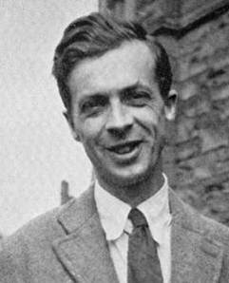
This is how Julian Huxley describes the “Hegelian Dialectic Process”: …at the moment, two opposing philosophies of life confront each other….

Slide 536
You may categorize the two philosophies as super nationalism, or as individualism versus collectivism…or as capitalism versus communism, or as Christianity verses Marxism. Can these opposites be reconciled, this antithesis be resolved in a higher synthesis? I believe not only that this can happen, but that, through the inexorable dialectic of evolution, it must happen.

Slide 537
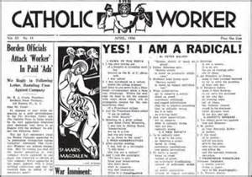
While the term “communitarian” is thought to date back to the 1840s, “communitarianism” has been made popular in the 20th century by Dorothy Day. Day, a Catholic, published the Catholic Worker Newspaper, promoting communitarianism and social justice.

Slide 538
Can the thesis, an idea, and the antithesis, an opposite idea, fight, conflict, synthesize, and merge together to produce a third option, or a mixture of both?

Slide 539
Huxley calls it the “the dialectic of evolution,” but many of today’s communitarians call it the “Third Way.”

Slide 540
Humanist Richard Rorty called communitarianism or the merging of socialism with capitalism; welfare-capitalism.

Slide 541
Rorty Explains Welfare-capitalism This Way: Most people on my side of this…cultural war have given up on socialism in light of the history of nationalization enterprises and central planning in Central and Eastern Europe.

Slide 542
Richard Rorty: We are willing to grant that the welfare-state capitalism is the best we can hope for. Most of us who were brought up Trotskyite now feel forced to admit that Lenin and Trotsky did more harm than good.

Slide 543
Robert Klenck Summarizes the Dangers of the Seeker-Sensitive Church Growth Movement: ...in this movement, it is imperative that unbelievers are brought into the church; otherwise, the process of continual change cannot begin. There must be an antithesis (unbelievers) present to oppose the thesis (believers), in order to move towards consensus (compromise),

Slide 544
Robert Klenck: and move the believers away from their moral absolutism (resistance to change). If all members of the church stand firm on the Word of God, and its final authority in all doctrine and tradition, then the church cannot and will not change. This is common faith. Soon, we will see why these “change agents” are pushing so hard for change to occur in the church.

Slide 545
Change agents have deliberately brought the Hegelian Dialectic Process into the Church in order to set up conflict. They know that for their transformation of the church to be effective, they need discord so people will tire of disagreeing and be willing to compromise biblical truth so as to attain consensus.

Slide 546
Communitarian Church Growth Movement is Built on: ∙ Societal evolution; ∙ Spiritual evolution; ∙ The social gospel is proclaimed instead of the biblical Gospel;

Slide 547
Communitarian Church Growth Movement is Built on: ∙ The end justifies the means; ∙ Pastors are not shepherds but managers; ∙ Church members are customers; ∙ Pastors are community organizers;

Slide 548
∙ Marketing and managing is emphasized instead of preaching and praying; ∙ Felt needs should determine church programming. Some Common Phrases Used by the Communitarians Include: ∙ Shared opportunity, ∙ Shared community,

Slide 549
Some Common Phrases Used by the Communitarians Include: ∙ Shared experience, ∙ Shared values, ∙ Common good, ∙ Social justice,

Slide 550
Some Common Phrases Used by the Communitarians Include: ∙ Healthy society, ∙ Third Way, ∙ Group consensus, ∙ New World Order, ∙ Global governance.

Slide 551
Interfaith Dialogue:

Slide 552
Leith Anderson of the National Association of Evangelicals, Bill Hybels of Willow Creek Church in Chicago, and Rick Warren of Saddleback Church, along with nearly 130 others, signed onto “A Common Word at Yale.”

Slide 553
These “Christian” leaders were responding to an open letter written by Muslim leaders and released on October 13, 2007. The Christians who signed the “Yale document” agreed that:

Slide 554
Yale Document: What is common between us lies not in something marginal nor in something merely important to each. It lies, rather, in something absolutely central to both: love of God and love of neighbor….

Slide 555
Yale Document: We applaud that A Common Word Between Us and You stresses so insistently the unique devotion to one God….We find it equally heartening that the God whom we should love above all things is described as being Love. In the Muslim tradition, God, “the Lord of the worlds,” is “The Infinitely Good and All-Merciful”….

Slide 556
Yale Document: “Let this common ground” – the dual common ground of love of God and of neighbor – “be the basis of all future interfaith dialogue between us,” your courageous letter urges. Indeed, in the generosity with which the letter is written you embody what you call for. We most heartily agree.

Slide 557
Yale Document: Abandoning all “hatred and strife,” we must engage in interfaith dialogue as those who seek each other’s good, for the one God unceasingly seeks our good. Indeed, together with you we believe that we need to move beyond “a polite ecumenical dialogue between selected religious leaders” and work diligently together to reshape relations between our communities and our nations so that they genuinely reflect our common love for God and for one another…

Slide 558
Yale Document: We are persuaded that our next step should be for our leaders at every level to meet together and begin the earnest work of determining how God would have us fulfill the requirement that we love God and one another.

Slide 559
Christians do not serve the same God as the Muslim. Allah is not the God of the Bible. In fact, Allah, in the Koran, fits the definition and the characteristics that we find of Satan in the Bible. We don’t worship the same God, and clearly, Muslims don’t love their neighbors as themselves. Islam teaches its followers to be nice until they have the upper hand, and then they will slay or enslave any “infidel.”

Slide 560
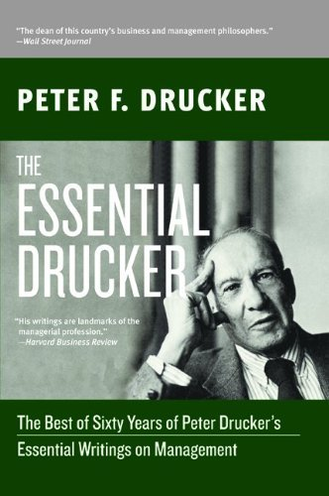
Peter Drucker: The Architect of the Communitarian Church Growth Movement

Slide 561
In a U.S. News and World Report article entitled, “Preacher with a Purpose,” Jeffery Sheler reveals that Rick Warren has called Peter Drucker one of his mentors:

Slide 562
His [Warren’s] most important role models he says, have been Billy Graham (“a model of great integrity”), Drucker (“a personal mentor on managing rapidly growing organizations”), and his late father, a Baptist minister.

Slide 563
Warren Boasted Many Times About Being Mentored by Peter Drucker: The most significant sociological phenomenon of the first half of the twentieth century was the rise of the corporation. The most significant sociological phenomenon of the second half of the twentieth century has been the development of the large pastoral church—of the megachurch.

Slide 564
Rick Warren: It is the only organization that is actually working in society. Now Drucker has said that at least six times. I happen to know because he’s my mentor. I’ve spent twenty years under his tutelage learning about leadership from him, and he’s written it in two or three books, and he says he thinks it’s the only thing that really works in society.

Slide 565
In an interview with ABC News Reporter Jake Tapper, Warren Glowed: We’ve trained now almost 500,000 church leaders around the world in 162 countries. I’ve been training leaders for twenty-eight years, business leaders, government leaders, church leaders.

Slide 566
The December 24, 2002 issue of Business Week featured an article on Peter Drucker entitled “Peter Drucker’s Search for Community” in which Ken Witty explains the foundation of Drucker’s thinking:

Slide 567
He brings a communitarian philosophy to his consulting.... He said that what he’s all about is this search for community, the search for where people and organizations find community for non-economic satisfaction....

Slide 568
“Emerging Partnerships: New Ways in a New World” was a symposium organized by The Peter F. Drucker Foundation and sponsored by The Rockefeller Brothers Fund in December 1996. Its purpose is as follows:

Slide 569
“The Drucker Foundation believes that a healthy society requires three vital sectors: a public sector of effective governments; a private sector of effective businesses; and a social sector [churches] of effective community organizations.”

Slide 570
A merging of churches, corporations, and government is also known as the “three-legged stool,” a favorite term used by Drucker disciple Rick Warren.

Slide 571
The October 5, 1998 Issue of Forbes Magazine Quotes Drucker’s Attitude Towards Absolutes: But a social discipline, such as management, deals with the behavior of people and human institutions. The social universe has no natural laws as the physical sciences do. It is thus subject to continuous change. This means that assumptions that were valid yesterday can become invalid and, indeed, totally misleading in no time at all.

Slide 572
In his book, Landmarks of Tomorrow, Drucker Explains His Commitment to Pagan Spirituality: “Society needs a return to spiritual values—not to offset the material but to make it fully productive. . . . Mankind needs the return to spiritual values, for it needs compassion. It needs the deep experience that the Thou and the I are one, which all higher religions share.”

Slide 573
The belief that we are all one is monism. The belief that God is all is pantheism, and the belief that God is in all is panentheism.

Slide 574
Drucker on His Spiritual Standing Said in a Video Interview: “I’m not a born again Christian; no. I’ve been going to church and conducted tithing all my life but I do not claim to be…if you read one thing of mine read my essay on Kierkegaard…it is the best thing I ever wrote easily but it’s also the only thing I ever wrote about religion.”

Slide 575
In “Management’s New Paradigms,” Published in the October 5, 1998 issue of Forbes Magazine, Drucker Declared: So the nonprofit social sector [churches] is where management is today most needed and where systematic, principled, theory-based management can yield the greatest results fastest.

Slide 576
Peter Drucker Declared: Just think of the enormous problems facing the world—poverty, health care, education, international tension—and the need for managed solutions becomes loud and clear.

Slide 577
In the 1953 Congressional hearings, the communists make it clear that they wanted to move the Church away from theological and doctrinal things and make it more about materialism. This emphasis on the material matches perfectly with communitarianism and the redistribution of wealth.

Slide 578
The Leader to Leader Website, Established in 1990 as the Peter F. Drucker Foundation for Non-profit Management, Declared: The Leader to Leader Institute will chart the future path for the social sector as the equal partner of business and government in developing responsible leaders, caring citizens, and a healthy, inclusive society.

Slide 579
Merging Church and Culture

Slide 580
A Baptist Press article entitled “Church Growth Scholar Advocates Radical Change in New Millennium” detailed the agenda of Fuller Theological Seminary professor Eddie Gibbs:

Slide 581
“Eddie Gibbs, professor of church growth at Fuller Theological Seminary, Pasadena, California, speaking during the annual meeting of the American Society for Church Growth at Golden Gate Seminary’s Mill Valley, Calif., campus Nov. 12-14, Gibbs warned churches must embrace transitions or ‘forfeit the possibility of exercising a transformational ministry within changing cultures.’”

Slide 582
The Communitarian Church Growth Movement is transitioning traditional churches by bringing in unbelievers to conflict with the believers. The church gradually moves from being a traditional church to a transitional church to finally becoming a transformed church. In the end, the church has been completely transformed and become a totally different organization with a totally different purpose and goal.

Slide 583
Eddie Gibbs Declared: The church itself will need to go through a metamorphosis in order to find its new identity in the dialectic of gospel and culture. This new situation is requiring churches to approach their context as a missional encounter.

Slide 584
The Church does not need to find a “new identity.” It needs to return to the prescription, the formula, the biblical requirements of a New Testament Church. We do not need to merge the church and culture. Christians are called to be in the world, but not of the world.

Slide 585
According to Baptist Press: Gibbs Says: “For the church to become a missional church, a new kind of leader will be required,” Gibbs argued. “It will not simply be a matter of people with traditional mind-sets acquiring new ministry skills to supplement what they already know.”

Slide 586
This new breed is a pastor/leader who more closely resembles a community organizer promoting social justice than a biblical shepherd of the flock.

Slide 587
Social justice is the redistribution of wealth through socialism, and the social gospel is social justice embraced by the Church and given a Christian veneer by twisting and distorting the Word of God.

Slide 588
Worship Service or Customer Service?

Slide 589
In a Forbes Magazine Interview, Drucker Bridges Business and Church Strategies When He Says: “noncustomers are as important as customers, if not more important: because they are potential customers. … Yet it is with the noncustomers that changes always start.”

Slide 590
Hybels Seems Comfortable with the Drucker Model As He Declares: Unchurched people today are the ultimate consumers. We may not like it, but for every sermon we preach, they’re asking, “Am I interested in that subject or not?” If they aren’t, it doesn’t matter how effective our delivery is; their minds will check out.

Slide 591
The Communitarian-Driven Church

Slide 592
One Reporter Picked up on Warren’s Communitarianism When She Wrote: In his speech, Warren argued that the solution of the world’s greatest problems lies in what he called the “third partnership.” The third partnership involves a relationship between faith communities, the government and the business sector….“If business and government were able to solve the world’s problems by themselves, they would have done it by now. A combination of the public, profit and parish sector is needed.”

Slide 593
Warren Has Repeated the Communitarian Theme Many Times: The government has the administrative power to form agendas and set goals, the business sector can provide the expertise, the capital and the managerial skills, and the church can provide the distributive network and the local credibility.

Slide 594
Equipping Sheep or Entertaining Goats?

Slide 595
When the New Testament Church gathers together it is primarily about worship and “equipping” Christians for the work of ministry.

Slide 596
William Still Wrote: The pastor is called upon to feed the sheep. (Now that may seem quite obvious.) He is called upon to feed the sheep even if the sheep do not want to be fed. He is certainly not to become an entertainer of goats. Let goats entertain goats, and let them do it in Goatland. You will certainly not turn goats into sheep by pandering to their goatishness.

Slide 597
Peter Drucker in “Business of the Kingdom,” an article in Christianity Today, describes “the pastor as manager.”

Slide 598
The Pastor’s Job is to Feed the Sheep, Not to Entertain Goats. Scripture Commands: “Go ye therefore into the world,” not, “Hey, world, come ye therefore into here.” The model for the biblical New Testament Church is to be a place to equip and train believers and then send them out. “Out there” they evangelize, and preach the Gospel to the lost.

Slide 599
Rick Warren’s Theology and Worldview

Slide 600
In The Purpose Driven Life, Warren positively quotes no less than nine mystics: Thomas Carlyle (page 27), Bernie Siegel (page 31), Henry David Thoreau (page 32), Brother Lawrence & Benedictine monks (page 88-89), Gary Thomas (page 102-103), St. John of the Cross (page 108), Henry Nouwen (page 108, 269), Madame Guyon (page193), William James (page 285).

Slide 601
On Page 88 Warren Writes: “The classic book on learning how to develop a constant conversation with God is Practicing the Presence of God.”

Slide 602
Brother Lawrence, the author of that book, was a monk who lived from 1614 to 1691 and believed God is in all things. This is panentheism, and it is a major doctrine of spiritual evolution, foundational for the globalist and communitarian worldview. So Warren believes a book that promotes the mysticism of contemplative prayer is a Christian classic?

Slide 603
In 2011, in an attempt to introduce more people to his church, Warren and his team orchestrated a diet and exercise program featuring three doctors known for promoting the occult. The Daniel Plan, as it was called featured Dr. Mehmet Oz, a cardiac surgeon and TV show host, Dr. Mark Hyman, an expert in metabolism, and Dr. Daniel Amen, a bestselling author and clinical professor of psychiatry at UC Irvine.

Slide 604
The Orange County Register Quoted Warren as Saying: “This is the greatest opportunity for you to introduce friends to Saddleback Church through a non-threatening event.”

Slide 605
The November/December 2007 issue of Spirituality and Health featured an article written in part by Dr. Oz, one of Rick Warren’s Daniel Plan fitness experts. In the article, Dr. Oz reveals why he follows the cult of Dr. Emanuel Swedenborg.

Slide 606
Swedenborg was a cult leader who mocked the Word of God and the exclusivity of Jesus Christ. He dismissed the idea of God’s judgment on those who do not repent and place their faith and trust in Jesus Christ. Why would Rick Warren allow such a false teacher onto his church platform to deceive both the saved and unsaved at his church? Dr. Oz is also a practicing Muslim.

Slide 607
Dr. Daniel Amen is Author of Change Your Brain, Change Your Body, in Which He stated: In my book, The Brain in Love, I wrote about tantric sexual practices. I was fascinated by the concept. I wanted to experience it for myself, and thought it would be a wonderful way to embrace my relationship with my wife Hannah. Tj Bartel became our teacher. I felt as if I had to share his knowledge with everyone I knew.

Slide 608
Christian Author and New Age Expert Ray Yungen Explains Tantric Sex: Tantra is the name of the ancient Hindu sacred texts that contain certain rituals and secrets. Some deal with taking the energies brought forth in meditation through the chakras and combining them with love-making to enhance sexual experiences.

Slide 609
In another of his books, Making a Good Brain Great, Dr. Amen recommends “an active form of yoga meditation called Kriya Kirtan. It is based on the five primal sounds saa, taa, naa, maa, aa.” Dr. Amen suggests doing this for 12 minutes, but make no mistake: this is nothing less than a mantra for the purpose of entering into an altered state of consciousness.

Slide 610
Rick Warren’s promotion of Oz and the like is what you get when you do not center on biblical theology in a church. The church ends up promoting whatever it takes to appeal to the unsaved world and to attract more customers—even if it means promoting those that are promoting the doctrines of demons!

Slide 611
The Biblical Model for the New Testament Church

Slide 612
Number One: A Biblical New Testament church is about equipping the saints for the work of ministry. We’ve already seen this characteristic in Ephesians 4:11-12.

Slide 613
Romans 10:13-17 Declares: How then shall they call on Him in whom they have not believed? And how shall they believe in Him of whom they have not heard? And how shall they hear without a preacher? And how shall they preach unless they are sent?

Slide 614
A New Testament church equips the saints for the work of ministry, which includes sending people out to preach the Gospel to the world, not bringing the world into the Church, and catering to them.

Slide 615
If the Gospel is being preached, the unsaved should be uncomfortable and under conviction, as we see in 2 Corinthians 7:9-11: Now I rejoice, not that you were made sorry, but that your sorrow led to repentance. For you were made sorry in a godly manner, that you might suffer loss from us in nothing.

Slide 616
For godly sorrow produces repentance leading to salvation, not to be regretted; but the sorrow of the world produces death. For observe this very thing, that you sorrowed in a godly manner: What diligence it produced in you, what clearing of yourselves, what indignation, what fear, what vehement desire, what zeal, what vindication! In all things you proved yourselves to be clear in this matter.

Slide 617
Acts 6:7 Reveals What Happens When People Hear the Truth: “Then the word of God spread, and the number of the disciples multiplied greatly in Jerusalem, and a great many of the priests were obedient to the faith.”

Slide 618
Rick Warren has said: “the Pulpit is the ultimate tool for church growth.”

Slide 619
Pastors or teachers are not to use the pulpit as a marketing tool. More than 50 years ago, Merrill Unger warned of what we’re seeing today:

Slide 620
Merrill Unger: To an alarming extent the glory is departing from the pulpit of the twentieth century. The basic reason for this gloomy condition is obvious. That which imparts the glory has been taken away from the center of so much of our modern preaching and placed on the periphery. The Word of God has been denied the throne and given a subordinate place.

Slide 621
Number Two: A Biblical Church Has Godly Leadership.

Slide 622
Number Three: A biblical church faithfully preaches the whole counsel of the Word of God.

Slide 623
Number Four: A biblical church prays for God to build His Church.

Slide 624
These Three Characteristics Are Made Clear in Acts 6:3-4: Therefore, brethren, seek out from among you seven men of good reputation, full of the Holy Spirit and wisdom, whom we may appoint over this business; but we will give ourselves continually to prayer and to the ministry of the word.

Slide 625
So, how is a New Testament church to be conducted, and how does a New Testament church grow? By picking godly men with godly reputations as leaders, full of the Holy Spirit, full of wisdom, who will preach and pray. The Scriptures are clear that God adds to His Church as people are being saved.

Slide 626
How is the unbeliever saved? By hearing the Word of God and being convicted by the Holy Spirit of sin. This results in godly sorrow that produces repentance unto salvation.

Slide 627
Number Five: A Biblical Church Loves the Lord and Not the World. First John 2:15: “Do not love the world, or the things in the world. If anyone loves the world, the love the Father is not in him.”

Slide 628
Number Six: A Biblical church is not Ashamed of the Gospel.

Slide 629
Many seeker sensitive pastors and authors call for the “contextualizing” of the Gospel. What they really mean is that the church needs to dilute the Gospel so it is more appealing to the culture.

Slide 630
Contextualization, as practiced by the false church, is not preaching the biblical Gospel that transforms people living in the culture but is, rather, the preaching of a social gospel by people who were transformed by the culture.

Slide 631
Romans 1:16: “For I am not ashamed of the Gospel of Christ, for it is the power of God to salvation for everyone who believes, for the Jew first, and also for the Greek.”

Slide 632
2 Timothy 4:1-4: I solemnly charge you in the presence of God and of Christ Jesus, who is to judge the living and the dead, and by His appearing and His kingdom: preach the word; be ready in season and out of season; reprove, rebuke, exhort, with great patience and instruction.

Slide 633
For the time will come when they will not endure sound doctrine; but wanting to have their ears tickled, they will accumulate for themselves (false) teachers in accordance to their own desires; and will turn away their ears from the truth, and will turn aside to myths.

Slide 634
Number Seven: A biblical church will suffer persecution. Second Timothy 3:12 cautions, “Yes, and all who desire to live godly in Christ Jesus will suffer persecution.”

Slide 635
Conclusion: Neutralizing the Opposition

Slide 636
The communitarian church growth movement is a deliberate strategy to infiltrate the Church and transform it from being an opponent of the demonic goals of global governance to being a willing participant and promoter of its goals.

Slide 637
Whether you call them communitarians, Fabians, globalists, statists, internationals, New Agers, or progressives, the goal is global governance. Whether they know it or not, these people are building Satan’s kingdom, but I have news for them: Daniel 2:44 promises that God will crush Satan’s kingdom and that God’s Kingdom will have no end.

Slide 638
Globalists seek to neutralize, infiltrate, compromise, and co-opt the opposition and create a religious Trojan horse.

Slide 639
The reason many Christians are so easily deceived is that they lack discernment. Yet discernment comes from the study of doctrine. Doctrine reveals the will of God for our lives, and it presents biblical truth.

Slide 640
Lesson 6: The Watermelon Church: Environmental Green and Socialist Red

Slide 641
The Church of the Nazarene Released its “Creation Care” Document Which Declared: “In this most critical moment in Earth’s history, we are convinced that the central moral imperative of our time is the care for Earth as God’s creation.

Slide 642
The Church of the Nazarene Released its “Creation Care” Churches, as communities of God’s people in the world, are called to exist as representatives of the loving Creator, Sustainer, and Restorer of all creation. We are called to worship God with all our being and actions, and to treat creation as sacred. We must engage our political leaders in supporting the very future of this planet. We are called to cling to the true Gospel–for “God so loved the world” (John 3:16).

Slide 643
Lynne Hybels Wrote: I look forward to the day when we as a church will be known for being the greenest church on the planet, not just because we enjoy the beauty of God’s creation, but because we know that climate change is a justice issue.

Slide 644
Bill Hybels admitted he was a Progressive—Yet Another Name for “Socialist”—in His Endorsement of Jim Wallis’ Book The Great Awakening: Progressive and centrist evangelicals are one stirring away from a real awakening. We are interested in the poor, in racial reconciliation, in global poverty and AIDS, in the plight of women in the developing world. What Wallis has been talking about is coming to fruition.

Slide 645
The SBC-authored article in the Directory of Environmental Activities and Resources in the North American Religious Community boasted that the Southern Baptist Convention’s Christian Life Commission hosted an environmental conference that “offered participants guidance in starting recycling programs at their own churches.” The article also lauded the SBC for producing a brochure on “the need for…social justice in making energy choices.”

Slide 646
A New York Times, Article by John Tierney Entitled “Recycling Is Garbage” Revealed: “People in New York and other places are tilting at recycling windmills,” says Porter, who left the E.P.A. in 1989 and is now president of a consulting firm, the Waste Policy Center in Leesburg, Va.

Slide 647
Recycling Is Garbage: “There aren’t many more materials in garbage that are worth recycling.” Porter has been advising cities and states to abandon their unrealistic goals, but politicians are terrified of coming out against recycling. How could they explain it to the voters? How could they explain it to their children?

Slide 648
John Tierney’s Article Revealed: “recycling newsprint actually creates more water pollution than making new paper: for each ton of recycled newsprint that’s produced, an extra 5,000 gallons of waste water are discharged.”

Slide 649
An Article in the Bismarck Tribune Summed up the Times Article This Way: Few people know that almost all the virgin pulp that goes into making paper is produced on tree farms that wouldn’t exist if we didn’t use these trees to make paper. Secondly, it’s a fact that we have three times more trees than we did in 1920. Recycling paper is a manufacturing process that can save landfill space but produces a harmful chemical sludge that must be disposed of properly. It would be safer to allow these products to biodegrade naturally.

Slide 650
Bismarck Tribune: According to the New York Department of Sanitation, it costs $50 to $60 a ton to pick up the regular garbage and take it to a landfill. It then costs $150 a ton to deal with the recyclables, and at least 40 percent of what is separated to be recycled ends up in the same landfill as the regular trash anyway.

Slide 651
It is precisely because parents and church leaders have not addressed from a biblical perspective issues such as radical environmentalism and the rise of earth worship that so many churched youth buy into philosophies that are not truly Christian.

Slide 652
Colossians 2:8: Beware lest anyone cheat you through philosophy and empty deceit, according to the tradition of men, according to the basic principles of the world, and not according to Christ.

Slide 653
God’s Global Warming

Slide 654
God is going to preserve the earth until He judges it with fire at the end of the thousand year millennium before God creates a new heaven and new earth.

Slide 655
2 Peter 3:7: “But the heavens and the earth which are now preserved by the same word, are reserved for fire until the day of judgment and perdition of ungodly men.”

Slide 656
In Isaiah 51:6, the Bible Says the Earth Will Grow Old and Worn Out Like an Old Shirt: Lift up your eyes to the heavens, And look on the earth beneath. For the heavens will vanish away like smoke, The earth will grow old like a garment, And those who dwell in it will die in like manner; But My salvation will be forever, And My righteousness will not be abolished.

Slide 657
Sin wears down the earth and our bodies. Because of sin, death, disease, and dying entered the world.

Slide 658
Genesis 3:17-19 Recounts the Consequences that God Explained to Adam and Eve Because of Their Sin: Then to Adam He said, “Because you have heeded the voice of your wife, and have eaten from the tree of which I commanded you, saying, ‘You shall not eat of it’:

Slide 659
“Cursed is the ground for your sake; In toil you shall eat of it All the days of your life. Both thorns and thistles it shall bring forth for you, And you shall eat the herb of the field. In the sweat of your face you shall eat bread Till you return to the ground, For out of it you were taken; For dust you are, And to dust you shall return.”

Slide 660
Global warming proponents base their belief on the alleged fact that temperatures are rising. But are they? Here are the facts:

Slide 661
Professor Bob Carter, a geologist at James Cook University, Queensland, Australia, says the Global Warming theory is neither environmental nor scientific, but rather, “a self-created political fiasco.” Carter explains that “climate changes occur naturally all the time, partly in predictable cycles and partly in unpredictable cycles.”

Slide 662
According to Robert Essenhigh, professor of energy conservation at Ohio State University, the ice sheets at the poles have been melting since the early 1900s and the Earth’s warming had begun about the middle 1600s.

Slide 663
Some studies show that the earth’s temperature has risen, and others indicate it has fallen. Why can’t experts agree on the temperature? For starters, the earth’s temperatures are taken in two different ways, and one method is not as reliable as the other.

Slide 664
Dr. S. Fred Singer, an Atmospheric Physicist at George Mason University Explains: You have to be very careful with the surface record. It is taken with thermometers that are mostly located in or near cities. And as cities expand, they get warmer. And therefore they affect the readings. And it’s very difficult to eliminate this—what’s called the urban heat island effect.

Slide 665
Dr. S. Fred Singer: So I personally prefer to trust in weather satellites…And if you look through the summary [of the United Nation’s Intergovernmental Panel on Climate Change (IPCC)], you will find no mention of the fact that the weather satellite observations of the last twenty years show no global warming. In fact, a slight cooling. In fact, you will not even find satellites mentioned in the summary.

Slide 666
Dr. S. Fred Singer: These are the only global observations we have. They are the best observations we have. They cover the whole globe. They don’t cover the oceans very well, which is 70% of the globe. So you see, the [U.N.] summary uses data selectively, or at least it suppresses data that are inconvenient, that disagree with the paradigm, with what they’re trying to prove.”

Slide 667
In an issue of Newsweek International, Richard S. Lindzen of the Massachusetts Institute of Technology, wrote “Why So Gloomy” in which he pointed out that:

Slide 668
Richard S. Lindzen: …the ill effects of warming are overblown. Sea levels, for example, have been increasing since the end of the last ice age. When you look at recent centuries in perspective, ignoring short-term fluctuations, the rate of sea-level rise has been relatively uniform (less than a couple of millimeters a year).

Slide 669
Richard S. Lindzen: There’s even some evidence that the rate was higher in the first half of the twentieth century than in the second half. Overall, the risk of sea-level rise from global warming is less at almost any given location than that from other causes, such as tectonic motions of the earth’s surface. There is no compelling evidence that the warming trend we’ve seen will amount to anything close to catastrophe.

Slide 670
There are Three Primary Players Behind the Global Warming Myth:

Slide 671
1. Cosmic Humanists (New Agers): These folks believe in pantheism, that all is god and god is all and that mother earth should be worshipped. Radical environmentalists and animal rights extremists—many of whom come from this group—place more value on the earth and animals than on humans.

Slide 672
2. Globalists and Socialists: Globalists:—many of whom haunt the United Nations—intend to erode America’s national sovereignty and create a one-world government. The United Nations’ Global Warming treaty—the Kyoto Protocol—would seriously damage America’s free enterprise system, and yet it does not even apply to some of the world’s biggest polluters such as China and India.

Slide 673
3. Scientists and Think-Tanks. You’ve heard the old saying “follow the money”? When you follow the trail behind the GW myth, it leads you to “scientists” who are willing to say anything to keep government grant money flowing their way. Some studies place U.S. government spending on climate change as high as $4 billion dollars a year.

Slide 674
Tom DeWeese, President of the American Policy Center: Simply put, scientists know where the grants will come from to pay their salaries. Dr. Patrick Michaels, a leading opponent to the global warming scaremongers, calls it the federal/science paradigm. He describes it this way: Tax $ = Grants = Positive Feedback Loop to Get more Grants.

Slide 675
Tom DeWeese: Says Dr. Michaels, “What worker bee scientist is going to write a proposal saying that global warming is exaggerated and he doesn’t need the money? Certainly no one wanting advancement in the agency! There is no alternative to this process when paradigms compete with each other for finite funding.” The only ones who can openly oppose the party line of the day are those who don’t need the grants or who have some other source of funding. There aren’t many .

Slide 676
Tom DeWeese: The money is in global warming because it’s being pushed by a political agenda that wants power. They want power in Washington, power on the international stage, power over economic development, power over international monetary decisions, and power over energy. In short, power over the motor world.

Slide 677
Tom DeWeese: It’s driven by literally thousands of large and small non-governmental organizations (NGOs) sanctioned by the United Nations, and implemented by a horde of bureaucrats, university academics and an ignorant but pliable news media.

Slide 678
The GW crowd has told us that manmade carbon dioxide is the reason for the supposed rise in global temperatures. Robert Essenhigh, professor of energy conservation at Ohio State University, reveals the lie to their claim:

Slide 679
Robert Essenhigh: The two principled thermal-absorbing and thermal-emitting compounds in the atmosphere are water and carbon dioxide. However—and this point is continually missed—the ratio of water to carbon dioxide is something like 30-to-1 as an average value. At the top it is something like 100-to-1.

Slide 680
Robert Essenhigh: This means that the carbon dioxide is simply ‘noise’ in the water concentration, and anything carbon dioxide could do, water has already done. So, if the carbon dioxide is increasing, is it the carbon dioxide driving the temperature or is the rising temperature driving up the carbon dioxide? In other words, the carbon dioxide issue is irrelevant to the debate over global warming.

Slide 681
Dr. Sallie Baliunas, an astrophysicist who serves as senior scientist at the George C. Marshall Institute in Washington D.C. and who chairs the Institute’s Science Advisory Board, gave a lecture at the University of Texas entitled, “Warming Up to the Truth: The Real Story about Climate Change.”

Slide 682
Dr. Baliunas believes the warming and cooling of the earth is more related to solar variability than it is carbon dioxide in the atmosphere. In other words, the increase and decrease in solar output has led to the cyclical warming and cooling of the earth.

Slide 683
Lesson 7 Christian Shamanism and the Law of Attraction

Slide 684
Much of what we see in the Word of Faith movement and New Apostolic Reformation is “Christianized” shamanism. Dave Hunt warned about this growing trend in his 1985 best-selling book, The Seduction of Christianity, when he wrote:

Slide 685
Shamanism promises power to heal and transform through contact with a parallel universe of the spirit, from which this mysterious energy is allegedly drawn. That contact is said to be made in our minds: The thoughts we think and the words we speak become the vehicles of spiritual power. Those who accept this concept become victims of the great delusion that displaces God with self.

Slide 686
In seeking power for self, they have become susceptible to the power of Satan. Nevertheless, even as the irrefutable evidence mounts documenting its destructive and evil power, shamanism’s popularity and general acceptance is exploding in the secular world, and in “Christianized” forms is gaining increasing acceptance within the church.

Slide 687
Dave Hunt Warns of the Occult Foundation Upon Which a Vast Majority of the Word of Faith Movement is Based: The mental images that one is able to picture or visualize are no longer looked upon as mere figments of the mind, but as reality created by the mind that can even impact the physical world.

Slide 688
Dave Hunt: The intimate relationship between thinking, speaking, and seeing (and the power thereby produced) has formed the basis of occult theory for thousands of years. The metaphysical philosophy underlying Positive Thinking and Possibility Thinking as well as major aspects of the Positive Confession movement is founded upon the alleged power inherent within thoughts and words.

Slide 689
Dave Hunt was Correct When He Warned: …the terminology, while sounding biblical, promotes concepts that cannot be found in the Bible, but are found in occult literature and practice. Moreover, some of the Positive Confession leaders not only admit but teach that the methods, laws, and principles they use are also used successfully by occultists. Nowhere in the Bible does it indicate or even imply that the people of God are to use the same methods or powers as the pagans.

Slide 690
GLORIA COPELAND—You know, you’re the – you’re supposed to control the weather. I mean, Ken’s the primary weatherman at our house, but when he’s not there I do it. And you can see what’s happening out there. It shows just like they have on – at the weather – like on the news. I mean, he’s got the computer that’s got the current weather on it and all that for flying. So sometimes I’ll hear something, I’ll hear the thunder start, and maybe he’ll still be asleep, and I’ll say, “Ken, you need to do something about this.” [Laughter]

Slide 691
Gloria Copeland: And knowing that – but you are the one that has authority over the weather. One day Ken and Pat Boone, when we were at Hawaii at their house, and we were – they were setting outside, and there was a weather spout out over the ocean. And that’s like a tornado, except it hits the water. And so they were sitting there and they just watched it, rebuked it, and it never did anything.

Slide 692
Gloria Copeland: One day, I was in the airplane, in the back, and my little brother was in the back with me, and Ken was up front flying. And we were not in the weather, because we don’t fly bad weather, but we could see the weather over here. And I looked out the window and that tornado came down just like this, down toward the ground. And Ken said, “I rebuke you in the name of Jesus. You get back up there!”

Slide 693
Gloria Copeland: So this is how I learned how to talk to tornados. I saw this. And that tornado went [makes repeated whooping noise], even while I was watching. And my little brother was not a devout Christian at that time, and that was really good for him to see.

Slide 694
Gloria Copeland: So you’re the weatherman. You get out there—or the weatherwoman, whichever it is, and you talk to that thing, and you tell it, “You’re not coming here. I command you to dissipate! And you get back up there in Jesus’ name!” Glory to God. That—I won’t charge you extra.

Slide 695
Another popular Word of Faith teacher is Benny Hinn, who, like many Word of Faith teachers, seems to believe that instead of man serving God, God is to serve man. Note this interchange between Hinn and Myles Munroe:

Slide 696
BENNY HINN—We get the mind of God about His will, we pray it. When we pray it, we give him legal right to perform it.

Slide 697
MYLES MUNROE—Yes. Let me define prayer for you in this show. Prayer is man giving God permission, or license, to interfere in earth’s affairs. In other words, prayer is earthly license for heavenly interference….God can do nothing on earth, nothing has God ever done on earth without a human giving him access….Always looking for a human to give him power of permission. In other words, God has the power, but you got the permission. God got the authority and the power, but you got the license. So even though God can do anything, he can only do what you permit him to do.

Slide 698
Psalm 115:3: “But our God is in heaven; He does whatever He pleases.” Psalm 135:6: “Whatever the Lord pleases He does, in heaven and in earth.” And Psalm 103:19 announces, “The Lord has established His throne in heaven, and His kingdom rules over all.”

Slide 699
Jessie Duplantis is another popular Word of Faith teacher who describes a similarly impotent God:

Slide 700
Jessie Duplantis: I’m gonna say something, gonna knock your lights out. God has the power to take life, but he can’t. He got the power to do it, but he won’t. He’s bound. He can’t. He says death and life is in the power of whose son? Yours. You ready for this? You want something that’ll knock your lights out? You choose when you live. You choose when you die.

Slide 701
John Hagee Has Declared: When you walk into a hospital room and your friend is there, a member of your family is there, you have the power to say, “In the name of Jesus, I rebuke that disease,” and the God of heaven will heal that disease, when you are right with God in heaven.

Slide 702
Kenneth Copeland: People that get all upset at preachers who preach prosperity never have taken the time to pray and see if God wanted them to prosper financially, for some reason or another. God needs you saved. He needs you full of the Holy Ghost. He needs you well. And he needs you strong. And he needs you rich.

Slide 703
Benny Hinn’s Version of the False Gospel Perverts God’s Use of Signs and Wonders When Hinn Declares: “If the gospel doesn’t have – if the gospel lacks – if the preaching of the gospel lacks signs and wonders, it’s an empty shell.”

Slide 704
Benny Hinn: It’s as easy to get healed as it is to get forgiven. It’s as easy to receive physical healing as it is to receive forgiveness for sin. It’s just as easy to get healed. Healing is as easy as salvation. Do not complicate what is simple. Say it with me: It’s as easy to get healed as it is to get forgiven. Healing should never be separate from salvation.

Slide 705
The Word of Faith movement is a sister to the New Apostolic Reformation with its “prophets” and “apostles.” The NAR and WOF false teachers not only preach another gospel, but they preach philosophies and practices derived from the occult. The Church must beware of the Christian and pro-family leaders who have given these groups credibility.

Slide 706
The “Christian” Version of the Law of Attraction

Slide 707
In 2009 a DVD called The Source of the Secret was released. This DVD described how Christians could benefit from the Law of Attraction. That “Law” is one being widely promoted by New Agers on The Oprah Winfrey Show.

Slide 708
Author and Pastor Kerry Shook Appears on the DVD and Says: I have talked to a lot of people who said The Secret has forever changed my life, and I agree that it has. Because they’re putting biblical principles into their life whether they realize it or not, it is going to change their life. Now I want them to take a step further and give credit to the source, and the source is Jesus Christ.

Slide 709
How can these people say The Secret is a good thing when it is clearly false teaching? How can people appearing in The Source of the Secret say you need to look behind the source of New Age, Occult false teaching to Jesus Christ or to God? What Jesus or God are they talking about? It is certainly not the Jesus or God of the Bible. Only a false teacher would say the source behind The Secret is the God of the Bible.

Slide 710
In 1 Kings 18:20-21, Elijah declares to the Children of Israel, who mingled worship of God with pagan spirituality, that they must choose to whom they will pledge their allegiance. Elijah asked the Israelites, “How long will you falter between two opinions? If the Lord is God, follow Him; but if Baal, follow him.”

Slide 711
In 1985, Dave Hunt warned that such New Age teachings as the Law of Attraction would soon become mainstream in evangelicalism: Today’s church is being swept by a revival of New Thought, now called Positive Thinking, Possibility Thinking, Positive Confession, Positive Mental Attitude, and Inner Healing.

Slide 712
Dave Hunt: We are very concerned that this time New Thought, which represents inside the church what New Age is in the secular world, will not be forced out, but will remain within the evangelical church to contribute to the growing confusion and seduction. One of the most basic New Thought techniques is visualization, which is now firmly entrenched within the church. Even after it was forced out of mainstream Christianity early in this century, New Thought survived on the fringes of the church in extreme Pentecostalism.

Slide 713
Bob Harrison, Appears on The Source of the Secret and Proclaims: Knowing that millions of copies of The Secret book and video have been sold, and people have listened to it and read, I feel it is a positive thing because it can introduce them to the Law of Attraction, one of the principles that cause them to have greater success. But the danger is it’s not going to take them far enough unless they learn the Source.

Slide 714
First Timothy 4:1 Warns: “Now the spirit expressly says that in latter times some will depart from the faith, giving heed to deceiving spirits and doctrines of demons.”

Slide 715
The DVD never mentions the Gospel. No one in the DVD—not the producer or anyone he interviews—ever explains the way to meet this God they claim is the source behind the secret. The message is simply that the source of the secret is God and that the original book and DVD did not go far enough.

Slide 716
Shad Wehrli, Co-creator of The Source of The Secret, Says: The source to “The Secret” is God and a relationship with Him. He is the source for everything. And that’s when I saw the initial “Secret.” I saw that it was incomplete because it talked about the universe but not The One who created the universe, talked about creation, but not the Creator. And so, I saw that it was absolutely incomplete. The source is God. I mean, after all, the Law of Attraction sounds good, but how can you have a Law without a Lawgiver?

Slide 717
To help you grasp the scope of this problem, here is a listing of some of the other individuals and their statements that appeared on The Source of the Secret:

Slide 718
Ron McIntosh, Executive Director Victory Bible Institute: “What I love about The Secret is The Law of Attraction. It is an automatic law. It works whether you believe it or not. You are applying the Law of Attraction by manifesting your dominant thoughts, whether you realize it or not.”

Slide 719
John Bevere, Best-Selling Author and International Speaker: “The Law of Attraction and all the laws described in The Secret work, because they are laws that have already been established by God.”

Slide 720
Ed Gungor, NY Times Best-selling Author: “You can be an agnostic, you can be an atheist, you can be a whatever, a pagan, and you can learn the laws of sowing and reaping as well as the Law of Attraction. And you can bring good into the world. And God designed it that way.”

Slide 721
Alex Loyd N.D., Ph.D., founder of “The Healing Codes”: Rhonda Byrne [author of The Secret book] filmed me to be part of The Secret, but I was left on the editing floor. And I believe it was because I talked in that interview so much about how the Law of Attraction, yes, is real. But the thing that determines whether the Law of Attraction is going to work in your life or not is the condition of your heart.”

Slide 722
Kerry Shook, Pastor and Author: At the end of the day after you close The Secret book, are you going to follow just principles, the Law of Attraction and the Secret? Or, are you going to follow the Real Secret, Jesus Christ?”

Slide 723
The DVD Narrator Concludes by Saying: The discovery of the Law of Attraction is just the beginning. The journey can and must go deeper. Be inspired to continue your own journey as you search for and discover the Source behind these laws. For when you seek, you will find. And, through this journey, come face-to-face with a loving God, the true Source of Life, Love, and all the good you have ever known.

Slide 724
Joel Osteen’s New Age Life Now

Slide 725
The Source of the Secret offers the same message promoted by Joel Osteen.

Slide 726
One message by Osteen was titled “Speak Faith into Your Future.” His website summarizes the sermon as follows: What are you saying about your life and your future? Words of faith and victory? Or words of lack and despair? In order to be all that God has created you to be, it is imperative to get into agreement with what his Word says with your words.

Slide 727
Joel Osteen: With your words, you are either blessing or cursing your future. Proverbs 18:21 says, “Life and death are in the power of the tongue.” To walk in victory, you can’t talk defeat. To experience abundance, you can’t talk lack. Even during tough times, instead of using your words to describe the situation, use your words to change the situation.

Slide 728
Joel Osteen: Joel 3:10 says, “Let the weak say, ‘I am strong!’” Not, let the weak talk about their weakness. If you will train yourself to only speak victory to bless your future, then God is able to release His goodness in greater ways in your life. Make sure the words you are sending out are in the direction you want your life to go!

Slide 729
While words can harm people— the Bible does speak about the power of the tongue in James 3:2-8—the Bible does not teach that our words have creative power. Only God has the power to create. Our words cannot create our futures for good or ill.

Slide 730
Joel Osteen’s Website Described His Talk “The Power of I Am” as Follows: God created our words to have creative power. What follows the two simple words, “I Am,” will determine what type of life you have and will either bring success or failure in your life. Instead of saying negative “I Ams,” “I am unfocused.

Slide 731
Joel Osteen: I am never going to succeed,” say what God says you are. Declare “I am blessed, confident, loved, accepted.” When you change your “I Ams,” your life will change for the better. The seeds of greatness God’s placed on the inside will spring forth.

Slide 732
Joel Osteen’s Your Best Life Now, bears an uncomfortable and dangerous similarity to this most popular of New Age claims. Here are a few examples of the Osteen version:

Slide 733
Joel Osteen’s Your Best Life Now: “You will produce what you’re continually seeing in your mind. If you foster an image of defeat and failure, then you’re going to live that kind of life. But if you develop an image of victory, success, health, abundance, joy, peace, and happiness, nothing on earth will be able to hold those things from you.”

Slide 734
“You must conceive it in your heart and mind before you can receive it.” “You must look through your ‘eyes of faith’ and start seeing yourself as happy, healthy and whole.”

Slide 735
“What you will receive is directly connected to how you believe.” “We receive what we believe.”

Slide 736
“Learn how to conceive. Keep the image of what you want to become in front of you. You’re going to become what you believe.”

Slide 737
Have these and countless other persecuted Christians been beaten, jailed and murdered because they “received what they believed,” or did these terrible things happen to them because they did not “develop an image of victory, success, health, abundance, joy, peace, and happiness”?

Slide 738
Were eleven of Jesus’ disciples martyred because, “they received what they believed”? Were the disciples living under a “curse of poverty and defeat,” as Osteen says of so many? Here’s a roll call of questions I’d like to ask Mr. Osteen.

Slide 739
Why is it, Joel, That: • Paul and Matthew were beheaded? • Barnabas was burned to death? • Mark was dragged to death? • James, the less, was clubbed to death? • Peter, Philip, and Andrew were crucified? • Thomas was speared to death? • Luke was hung by the neck until dead? • Stephen was stoned?

Slide 740
God does not define our success in materialistic terms as Joel does. God is interested in our obedience above all. On page 63, Joel writes: “As long as you are pressing forward, you can hold your head up high, knowing that you are a ‘work in progress,’ and God is in the process of changing you. He’s looking at your last two good moves.”

Slide 741
Isaiah 64:6 says that even our righteous deeds are like filthy rags or wickedness to God because He is so holy unless seen through His Son Jesus Christ.

Slide 742
On page 144, Joel Osteen Makes This Heretical Statement: “you may even need to forgive God.”

Slide 743
Oswald Chambers Offers a Perspective on the Kind of Thing the Osteens of the World do to Christians: “Satan’s great aim is to deflect us from the center. He will allow us to be devoted to the death to any cause, any enterprise, to anything but the Lord Jesus.”

Slide 744
Understanding Mysticism:

Slide 745
Pastor Jack Hughes Explains Mysticism as Follows: So when someone says “God spoke to me,” the question to ask is, “How did God speak to you?” Are you using “to speak” metaphorically? Do you mean you had an experience and you think it was from God? Do you mean that you received revelation about God, by observing creation and what has been made, or through His law written in your heart, or through your conscience, i.e., by general revelation?

Slide 746
Pastor Jack Hughes: Was it information about God? If not, it wasn’t general revelation. If you believe you have received information about God, through general revelation, you should not live by that revelation, or act on it, since it is subjective, distorted by your sin nature, and the source of what you have experienced is unverifiable. The book Experiencing God teaches God speaks to us, but it does not qualify or meet the criteria for general revelation. Therefore, if it is not general revelation, it must qualify as special revelation.

Slide 747
Pastor Jack Hughes: Maybe you believe God gave you special revelation. When you say, “God spoke to me,” do you mean He literally spoke? Was it an act of “inspiration”? Did the Holy Spirit move you to receive the perfect inerrant Word of God? The problem with claiming to receive special revelation is that the Bible canon is closed and we cannot add to it (Deut. 4:2; 12:32; Prov. 30:5-6; Rev. 22:18-19; Jude 3). We must not follow the cults who claim to have revelation apart from the completed Biblical canon. The cults typically place their experiences above or on an equal plane with Scripture.

Slide 748
Pastor Jack Hughes: If God did not speak to you through inspiration, then the only other kind of special revelation left to consider is a direct encounter with God, i.e., a theophany or christophany. Are you saying that God appeared to you? Did you see the Shekinah glory, a burning bush, or a post-resurrection appearance of Christ and have God verbally speak to you? These questions must be answered.

Slide 749
Pastor Jack Hughes: Most people who claim to have had a “word from God” are not brazen enough to claim they have received special revelation in any of the ways described above. They want to claim that God “spoke to them,” but they must invent a new type of revelation that is not general, special, or orthodox. Yet, it is revelation from God that is able to guide them, give them direction and able to lead them through life.

Slide 750
Pastor Jack Hughes: There is a term for this; it is called “mysticism.” Mysticism is the belief that direct knowledge of God and His will are received by our spirit, through experience, apart from the Word of God. When a Christian begins to live and make decisions by intuition, hunches, feelings, perceptions, or things they “sense,” then they have become “mystics.” Mysticism is pagan. To depart from living by the objective revelation of God’s Word is to depart from God’s will (Deut. 8:3; Matt. 4:4; II Pet. 1:2-4).

Slide 751
Southern Baptists Now Embrace Word of Faith Teachings?

Slide 752
In an online Video Clip, Beth Moore Declares that God is Speaking to Her: “[God] began to say to me, ‘I’m gonna tell you something right now, Beth, and boy you write this one down, and you say it as often as I give you utterance to say it....’”

Slide 753
Jude 3 Declares: Beloved, when I gave all diligence to write unto you of the common salvation, it was needful for me to write unto you, and exhort you that ye should earnestly contend for the faith which was once delivered unto the saints.

Slide 754
Proverbs 30:5-6: “Every word of God is pure: he is a shield unto them that put their trust in him. Add thou not unto his words, lest he reprove thee, and thou be found a liar.”

Slide 755
Deuteronomy 12:32 Admonishes: “Whatever I command you be careful to observe it. You shall not add to it nor take away from it.”

Slide 756
Deuteronomy 4:2: “You shall not add to the word, which I command you, nor take from it that you may keep the commandments of the Lord your God which I command you.”

Slide 757
Beth Moore Seems to Embrace the idea of Positive Confession. In Describing Matthew 17:20-21, She Says: Look carefully at what that verse is saying. He said, “and you can say to the mountain.” For some reason ordained by God alone, He tells us that when we want something to move, we are to tell it to. That we are to open our mouths and say to the mountain, “Move it! You’re in my way!”

Slide 758
Beth Moore: Now I can tell you what’s going on right now. Some people are thinking, they’re already shutting off right here. Because they’re thinking, “Well, that is not for today.” Then why in the world did He leave us this word? Why in the world did He leave us this word? We are to confess with our mouths. He said, “Open your mouth and say.”

Slide 759
Beth Moore: When He spoke the worlds into existence, He didn’t just think them. He spoke them! And He set a precedent, and He’s saying to us, “My words are omnipotent, but your words are potent!” You stir up the faith within you, you look at that mountain, and you say, “Move it!” I’ve got to tell you something. God has been teaching me how to move some mountains with my voice.

Slide 760
God speaking the world into existence is not a precedent for us. God can create with His words, but we cannot. Standard Word of Faith heresy teaches that man’s words can create. That is not only heresy, it is shamanism; it is pagan; it is taught within the occult.

Slide 761
Matthew 17:20-21 and a corresponding passage of Mark 11:23-24 are not talking about us moving mountains with our words but about Christians praying and having faith that God can do things that we see as impossible. It is not you or I that move the mountain with our words, but it is God who does what we think is impossible.

Slide 762
Context is Vital. Look at Matthew 17:20-21 in Context: So Jesus said to them, “Because of your unbelief; for assuredly, I say to you, if you have faith as a mustard seed, you will say to this mountain, ‘Move from here to there,’ and it will move; and nothing will be impossible for you. However, this kind does not go out except by prayer and fasting.”

Slide 763
We have to have faith that God will do what He knows is best for us, and if it is God’s will, then He will do what we think is impossible, such as moving a mountain. God is the object and source of our faith. It is not having faith in the power of our words.

Slide 764
We Must Use Scripture to Interpret Scripture. First John 5:14-15 Tells Us That Whatever We Ask Has to Be in Accordance With God’s Will: Now this is the confidence that we have in Him, that if we ask anything according to His will, He hears us. And if we know that He hears us, whatever we ask, we know that we have the petitions that we have asked of Him.

Slide 765
Lesson 8 Christian Mysticism Goes Mainstream

Slide 766
T.A. McMahon of the Berean Call Asks and Answers a Very Important Question: “What can be done to stem the tide? Nothing that the Bible seems to indicate. On the other hand, God has given believers orders that appear to be designed more for a rescue operation than for a reversal of widespread apostasy.”

Slide 767
The falling away from biblically held truths is the increasing apostasy of today predicted in the Word of God thousands of years ago. Our responsibility is to preach the Gospel to the lost, warn the Church of wolves inside the flock, and to rebuke ignorant sheep who feed on the spiritual poison served up by hirelings masquerading as shepherds.

Slide 768
Mystical Practices That Have Gone Mainstream in Evangelical Circles Include: “Christian” yoga, Contemplative prayer, Soaking prayers or breath prayers (which are nothing less than transcendental meditation).

Slide 769
An Issue of Nashville’s Tennessean Newspaper Featured “Meditation Goes Mainstream,” Which Reported: Joe Scott, 61, got hooked on meditation in yoga classes about 16 years ago. At the time, he was an opinionated workaholic who had a need to always be right. “I used to be a very angry, intense person,” says Scott, who works in the quality assurance department at HCA.

Slide 770
Meditation Goes Mainstream: Thirty minutes of meditation first thing in the morning completely changed his life, says Scott, who also meditates with members of Self Realization Fellowship in Berry Hill, which incorporates readings from the Bible and the Hindu holy book in their Sunday services. For Carolyn Goddard of Nashville, she was drawn to centering prayer, a form of contemplative prayer, to deepen her connection with God. A Colorado monk revived this ancient ritual of “resting in God” in the 1970s as an alternative for Christians lured to transcendental meditation.

Slide 771
A Manual for Mysticism

Slide 772
Pastor Mike Bickle of the International House of Prayer was quoted on the IHOP website as stating: “I want this book to be the manual for IHOP-KC.”

Slide 773
Teresa of Avila was a Spanish mystic and Roman Catholic.

Slide 774
Theresa Taught Four Levels of Prayer: The four stages include, “mental prayer,” “prayer of quiet,” “devotion of union,” and “devotion of ecstasy or rapture.”

Slide 775
The Fourth Stage, “Devotion of Ecstasy or Rapture,” is Described by St. Teresa in Her Book Interior Castle: The fourth is the “devotion of ecstasy or rapture,” a passive state, in which the consciousness of being in the body disappears. Sense activity ceases; memory and imagination are also absorbed in God or intoxicated.

Slide 776
Teresa in Her Book Interior Castle: Body and spirit are in the throes of a sweet, happy pain, alternating between a fearful fiery glow, a complete impotence and unconsciousness, and a spell of strangulation, intermitted sometimes by such an ecstatic flight that the body is literally lifted into space. This after half an hour is followed by a reactionary relaxation of a few hours in a swoon-like weakness, attended by a negation of all the faculties in the union with God. From this the subject awakens in tears; it is the climax of mystical experience, productive of the trance.

Slide 777
Cathleen Medwick’s Teresa of Avila: The Progress of a Soul Recounts that Teresa at Times Levitated During this Process: Teresa’s rapture became so frequent as to be almost commonplace....The occasional visitor, like Bishop Alvaro de Mendoza, might be astonished to see the prioress, her hands pressed forward in prayer and her eyes rolled up to heaven, rise a foot or more off the ground.

Slide 778
Teresa of Avila: The Progress of a Soul: Teresa ordered that any sister who happened to be present during one of these levitations was to grab hold of her habit and try to hold her down. This, of course, was impossible, obedience being no match for celestial magnetism.

Slide 779
Interior Castle is Described on Amazon.com as Follows: Celebrated for almost five centuries as a master of spiritual literature, St. Teresa of Avila is one of the most beloved religious figures in history. Overcome one day by a mystical vision of a crystal castle with seven chambers, each representing a different stage in the soul’s spiritual quest for union with God, Teresa recorded her vision in this now classic text.

Slide 780
Interior Castle is Described on Amazon.com as Follows: Probably her most important and widely studied work, The Interior Castle guides the spiritual seeker through each chamber of the castle to the center and the soul’s final union with the divine.

Slide 781
Interior Castle is Described on Amazon.com as Follows: Free of religious dogma, this contemporary rendering is a beautiful and practical set of teachings for seekers of all faiths in need of guidance. Mirabai Starr’s introduction places this classic in a contemporary context, reasserting its spiritual and literary importance close to five hundred years after it was first published.

Slide 782
Saint Teresa of Avila Described Four Degrees or Stages of Mystical Union: 1. incomplete mystical union, or the prayer of quiet or supernatural recollection, when the action of God is not strong enough to prevent distractions, and the imagination still retains a certain liberty; 2. full or semi-ecstatic union, when the strength of the divine action keeps the person fully occupied but the senses continue to act, so that by making an effort, the person can cease from prayer;

Slide 783
Saint Teresa of Avila Described Four Degrees or Stages of Mystical Union: 3. ecstatic union, or ecstasy, when communications with the external world are severed or nearly so, and one can no longer at will move from that state; and 4. transforming or deifying union, or spiritual marriage (properly) of the soul with God.

Slide 784
The Catholic Catechism, Item #460, Declares: The Word became flesh to make us “partakers of the divine nature.” “For this is why the Word became man, and the Son of God became the Son of man: so that man, by entering into communion with the Word and thus receiving divine sonship, might become a son of God.”

Slide 785
The Catholic Catechism, Item #460, Declares: “For the Son of God became man so that we might become God.” “The only-begotten Son of God, wanting to make us sharers in his divinity, assumed our nature, so that he, made man, might make men gods.”

Slide 786
The IHOP’s Website Promoted a CD Set by Mike Bickle Entitled “Contemplative Prayer: The Journey into Fullness.” In it, Bickle Declares: mystics is a legitimate term... I don’t want to fight the war…so I’m just saying contemplative prayer, but I mean the mystics—even here at IHOP I say, let’s just stay with contemplatives …I don’t have time to argue… so I call them the contemplatives…. I don’t want to go into the semantics, the debates…so, I’m calling it the contemplatives… I don’t have time to argue… but I mean the mystics.

Slide 787
Mike Bickle: …a study of the lives of the mystics, the contemplatives, through history, and clearly the most inspiring, compelling examples of history, in my world, have come out of the Catholic dark ages. I can’t find anything like it in modern times, in America, in the Protestant world.

Slide 788
Reformed Preachers Promoting a Counter Reformation?

Slide 789
Rome’s counter-Reformation will lead apostate church right back into the arms of Rome, which I believe has been quietly infiltrating both Reformed churches and seminaries and non-Reformed churches and seminaries for hundreds of years in an attempt to re-introduce mysticism, pragmatism, social justice, communitarianism, dominion theology, and ecumenicalism.

Slide 790
For a time, Tim Keller’s Church Website Featured a Class Entitled “The Way of the Monk.”

Slide 791
The Class Description for Way of the Monk Was as Follows: Do you long for the great theology in your head to be more real to your heart? Come discover age-old methods of contemplative prayer and worship that can help you encounter Christ in a more intimate, experiential way.

Slide 792
The Class Description for Way of the Monk Was as Follows: In this hands-on workshop, you will experience the ancient art of chanting the Psalms (they were meant to be sung!), embark on a practice of authentic Christian meditation, discover how a simple, time-honored tool can help unleash the prayer warrior in you, learn what a typical monastic day is like and how you can make your own, private retreat at a monastery, and much more!

Slide 793
Keller’s Church Website Has Featured an Article by Jan Johnson That Promotes Lectio Divina, Which is Another Word for Contemplative Prayer. Johnson writes: As I tried to meditate on the discourse and poetic texts, such as the New Testament letters and Old Testament poets and prophets, I found that another classical method helped me: lectio divina. This kind of meditation has been used widely among believers since the sixth century.

Slide 794
Pope Benedict XVI Affirmed this Well-Known Catholic Mysticism When He Declared: I would like in particular to recall and recommend the ancient tradition of Lectio divina: the diligent reading of Sacred Scripture accompanied by prayer brings about that intimate dialogue in which the person reading hears God who is speaking, and in praying, responds to him with trusting openness of heart (cf. Dei Verbum, n. 25). If it is effectively promoted, this practice will bring to the Church—I am convinced of it—a new spiritual springtime.

Slide 795
In the book, Open Mind, Open Heart: The Contemplative Dimension of the Gospel, Catholic Priest Thomas Keating Wrote: The following principles represent a tentative effort to restate the Christian spiritual journey in contemporary terms. They are designed to provide a conceptual background for the practice of centering prayer. They should be read according to the method of lectio divina. The fundamental

Slide 796
In the book, Open Mind, Open Heart: The Contemplative Dimension of the Gospel, Catholic Priest Thomas Keating Wrote: goodness of human nature, like the mystery of the Trinity, Grace, and the Incarnation, is an essential element of Christian faith. This basic core of goodness is capable of unlimited development; indeed, of becoming transformed into Christ and deified.

Slide 797
In January 1979, at the “World Congress on Hinduism” in Allahabad, India, a Speaker Declared: “Our mission in the West has been crowned with fantastic success. Hinduism is becoming the dominant world religion and the end of Christianity has come near.”

Slide 798
Many once-biblical churches have embraced the mysticism of contemplative prayer, “Christian” yoga, and walking a labyrinth. They are no longer biblical churches and are no longer preaching and teaching biblical Christianity but the Eastern mysticism of Hinduism.

Slide 799
Jan Johnson Explains that Mystic Richard Foster, Who Also Writes Positively of Ignatius of Loyola, Assisted Her in Using her Imagination in Meditation: “But since I read Richard Foster’s words about ‘sanctifying the imagination’ many years ago, I’ve asked God to purify my imagination along with my heart, mind, and will.”

Slide 800
In His Book, Celebration of Discipline, Foster Writes About the Importance of the Imagination. However, as Researcher Bob DeWaay Points Out: “A search of the KJV [King James Bible] for ‘imagination’ yields 14 verses, and in each case it is a bad thing.”

Slide 801
Richard Foster Recommends: The inner world of meditation is most easily entered through the door of the imagination. We fail today to appreciate its tremendous power. The imagination is stronger than conceptual thought and stronger than the will.

Slide 802
Foster Proclaims that Through the Use of one’s Imagination People Can Actually See and Talk to Jesus Christ: As you enter the story, not as a passive observer but as an active participant, remember that since Jesus lives in the Eternal Now and is not bound by time, this event in the past is a living present-tense experience for Him.

Slide 803
Hence, you can actually encounter the living Christ in the event, be addressed by His voice and be touched by His healing power. It can be more than an exercise of the imagination; it can be a genuine confrontation. Jesus Christ will actually come to you.

Slide 804
Foster Believes You Can Use Your Imagination to be Involved in What Sounds Like Astral Projection or Astral Travel: In your imagination allow your spiritual body, shining with light, to rise out of your physical body. Look back so that you can see yourself lying in the grass and reassure your body that you will return momentarily.

Slide 805
Richard Foster: Imagine your spiritual self, alive and vibrant, rising up through the clouds and into the stratosphere….Go deeper and deeper into outer space until there is nothing except the warm presence of the eternal Creator. Rest in His presence. Listen quietly, anticipating the unanticipated. Note carefully any instruction given.

Slide 806
Note carefully any instruction given? So people are to listen for an audible voice? And just who or what would be talking to them? Could it be demons?

Slide 807
Foster Warns of Possibility Those Who Practice Contemplative Prayer Could Encounter Demons: I also want to give a word of precaution. In the silent contemplation of God we are entering deeply into the spiritual realm, and there is such a thing as supernatural guidance that is not divine guidance.

Slide 808
Richard Foster: While the Bible does not give us a lot of information on the nature of the spiritual world, we do know… there are various orders of spiritual beings, and some of them are definitely not in cooperation with God and his way! … But for now I want to encourage you to learn and practice prayers of protection…“All dark and evil spirits must now leave.”

Slide 809
Foster Admits He Was Influenced by Agnes Sanford: The advice…[of] prayer through the imagination…picture the healing…and much more, was given to me by Agnes Sanford. I have discovered her to be an extremely wise and skillful counselor….Her book The Healing Gifts of the Spirit is an excellent resource

Slide 810
Sanford Taught Many Pastors and Self-Professing Christians Her Philosophy of Prayer That is Steeped in Paganism: Wise men of India for many centuries have trod the lofty peaks of meditation, developing their psychospiritual powers and giving birth to their oversouls. Spirits of those [dead] for whom we have prayed on earth are working through us….

Slide 811
Agnes Sanford: One conveys that healing force to the inner being [of the sick] through the law of suggestion….He [the person doing the healing] has made a thought-track between his spirit, subconscious mind and body; and the body, the subconscious mind and the spirit of the patient….

Slide 812
Shamanism and Eastern Mysticism Are Twin Sisters, and Foster Seems to Have No Problem with the Latter When He Writes: No doubt part of the surge of interest in Eastern meditation is because the churches have abrogated the field. How depressing for a university student, seeking to know the Christian teaching on meditation, to discover that there are so few living masters of contemplative prayer and that nearly all of the serious writings on the subject are seven or more centuries old. No wonder he or she turns to Zen, Yoga, or TM.

Slide 813
Foster Thinks we Need Spiritual “Masters” in Our Churches? This Creates a Downward Spiral of Sorts. As Bob DeWaay Points Out: Once mysticism and the supposed need to gain personal revelations from God are embraced, there arises a need for new “masters” who are better at navigating the spirit world. Pagan societies have always had such persons. They are called “shamans.” Eastern religion calls them “gurus.” Deceived Christians call them “spiritual directors.”

Slide 814
Robert Schuller Advocated a Mystic Mush Derived From an Assortment of Questionable Sources: A variety of approaches to meditation…is employed by many different religions as well as by various non-religious mind-control systems. In all forms…TM, Zen Buddhism, or Yoga or…meditation…of Judeo-Christian tradition…the meditator endeavors to overcome the distractions of the conscious mind….It is important to remember that meditation in any form is the harnessing, by human means, of God’s divine laws….

Slide 815
Robert Schuller: We are endowed with a great many powers and forces that we do not yet fully understand. The most effective mantras employ the “M” sound. You can get the feel of it by repeating the words, “I am, I am,” many times over….Transcendental Meditation or TM…is not a religion nor is it necessarily anti-Christian.

Slide 816
In Christianity Today, Rick Warren’s Wife Kay Spoke of the “Profound” Influence Schuller Had on Her Husband: During his last year in seminary, he and Kay drove west to visit Robert Schuller’s Institute for Church Growth. “We had a very stony ride out to the conference,” she says, because such nontraditional ministry scared her to death. Schuller, though, won them over. “He had a profound influence on Rick,” Kay says. “We were captivated by his positive appeal to nonbelievers. I never looked back.”

Slide 817
The Crystal Cathedral Website Also Confirmed The Influence of Schuller on Rick Warren: Since 1970, Dr. Schuller has taught more than 20,000 church leaders this approach to church growth at the Robert Schuller Institute for Successful Church Leadership. Institute alumni include pastors Bill Hybels and Rick Warren.

Slide 818
These Are Nine Mystics Rick Warren Quotes Affirmatively in The Purpose Driven Life: ● Thomas Carlyle (page 27); ● Bernie Siegel (page 31); ● Henry David Thoreau (page 32); ● Brother Lawrence & Benedictine monks (page 88-89); ● Gary Thomas (page 102-103); ● St. John of the Cross (page 108); ● Henry Nouwen (page 108, 269); ● Madame Guyon (page 193); ● William James (page 285).

Slide 819
Of Catholic Monk Brother Lawrence, Warren Writes: “The classic book on learning how to develop a constant conversation with God is Practicing the Presence of God. It was written in the seventeenth century by Brother Lawrence, a humble cook in a French monastery.”

Slide 820
Another Proponent of Brother Lawrence was C.S. Lovett, Wrote: Around 300 years ago there was a French monk by the name of Brother Lawrence, who…developed the art of visualizing the Lord Jesus, and it revolutionized his life…. THE MOST NOBLE AND GLORIOUS PURPOSE OF THE IMAGINATION IS GVING REALITY TO THE UNSEEN LORD!...

Slide 821
C.S. Lovett, Wrote: As you know, many tend to be superstitious about picturing the Lord….But you see, the Lord doesn’t care ONE BIT how we visualize Him….Picture Him any way you wish, but love Him….I know from experience your enjoyment of Him is going to be greatly enhanced by giving Him arms with which to hold you. [emphasis in original]

Slide 822
Occult expert Dave Hunt Warns That The Attempt to Visualize Jesus is Clearly Occultism: In visualizing “God” or “Jesus” or the thing being prayed for, the average Christian is not aware that he is following the same procedure that shamans insist opens a “magic doorway” in the mind that leads to the sorcerer’s world.

Slide 823
Dave Hunt Warns: This simple but powerful technique (long used by shamans for entering the spirit realm in order to contact and bargain with spirit entities) has gained acceptance in today’s medicine, psychology, success/motivation, and education. It is also being promoted and taught by an alarming and increasing number of Christian leaders, who urge us to visualize our concept of “Jesus” and promise that the image we create in our minds will become the real Jesus, who will then make genuine contact with us.

Slide 824
Nowhere in the Word of God are we called to visualize Jesus Christ.

Slide 825
After the ascension of Jesus Christ there is never again a mention of Jesus Christ appearing to anyone, except to Paul on the Damascus road. In Acts 1:9-11, the disciples were told by two angels that Jesus would come again the same way they saw Him leave:

Slide 826
Acts 1:9-11: Now when He had spoken these things, while they watched, He was taken up, and a cloud received Him out of their sight. And while they looked steadfastly toward heaven as He went up, behold, two men stood by them in white apparel, who also said, “Men of Galilee, why do you stand gazing up into heaven? This same Jesus, who was taken up from you into heaven, will so come in like manner as you saw Him go into heaven.”

Slide 827
The Two Angels Did Not Tell The Disciples: , “Hey, guys, if you want to see Jesus again, just find a quiet place, close your eyes, quote a mantra over and over, enter into the silence, and Jesus will appear to you.”

Slide 828
First Peter 1:8 Does Not Say: “whom we see whenever we want through visualization” but rather: “whom having not seen you love. Though now you do not see Him, yet believing, you rejoice with joy inexpressible and full of glory, receiving the end of your faith—the salvation of your souls.”

Slide 829
In 2 Corinthians 5:6-8, Paul Gives Us More Biblical Proof That While on this Earth in Our Temporal Bodies, We Do Not See The Lord: So we are always confident, knowing that while we are at home in the body we are absent from the Lord. For we walk by faith, not by sight. We are confident, yes, well pleased rather to be absent from the body and to be present with the Lord.

Slide 830
In Philippians 1:22-24, Paul Writes About Not Seeing The Lord in His Fleshly Body While Here on Earth: But if I live on in the flesh, this will mean fruit from my labor; yet what I shall choose I cannot tell. For I am hard-pressed between the two, having a desire to depart and be with Christ, which is far better. Nevertheless to remain in the flesh is more needful for you.

Slide 831
After His ascension into heaven, Scripture tells us over and over that the only way a Christian will see the Lord is either upon his death or if he is alive at the time of the rapture or Second Coming.

Slide 832
Pornographic Divination

Slide 833
Mark Driscoll Dwells on The Mystical While We Are Called to Focus on What is Godly. Philippians 4:8 Admonishes Us: Finally, brethren, whatever things are true, whatever things are noble, whatever things are just, whatever things are pure, whatever things are lovely, whatever things are of good report, if there is any virtue and if there is anything praiseworthy—meditate on these things.

Slide 834
Kenneth Hagin Described His “Revelation”: Suddenly I was gone! Right in the middle of my sermon, I found myself standing along a street in a little town fifteen miles away—and I knew it was Saturday night. I was leaning against a building, and I saw this young lady come walking down the street. About the time she got to where I was standing, a car came down the street. The driver pulled up to the curb, sounded the horn, she got into the car. He backed out, turned the other direction, and started out of town—and suddenly I was sitting in the back seat!

Slide 835
Kenneth Hagin Described His “Revelation”: They went out in the country and committed adultery. And I watched them. I was still in the cloud. Suddenly I heard the sound of my voice, and the cloud lifted. I was standing behind my pulpit. I didn’t know what to say, because I didn’t know what I had been saying, so I just said “Everyone bow your head,” and we prayed. I looked at my watch, and…I’d been gone about fifteen minutes in the cloud.

Slide 836
Kenneth Hagin Described His “Revelation”: While I was shaking hands with people as they went out the door, this young lady came by. I said, “We missed you last night.” She said, I was over in ______” (and she named the little town). I said, “Yes, I know.”

Slide 837
Many people quote Joel 2:28 to say that dreams and visions that include extra-biblical revelations are viable today. There is, however, a serious problem with their interpretation. Joel 2:28 describes something that happens during the tribulation to the house of Israel as this verse is written to the Jewish people and it refers to “your sons and your daughters.”

Slide 838
Lesson Nine: Twenty Characteristics of False Teachers Embraced by the False Church

Slide 839
1. False Teachers are Insincere and Use God’s Word for Personal Gain. 2 Corinthians 2:17—For we are not like the many who market God’s message for profit. On the contrary, we speak with sincerity in Christ, as from God and before God (HCSB).

Slide 840
2. False Teachers Appeal to the Flesh and Sin Nature of People 2 Peter 2:18—For when they speak great swelling words of emptiness, they allure through the lusts of the flesh, through lewdness, the ones who have actually escaped from those who live in error.

Slide 841
“Actually escaped”” is better translated “trying to escape or barely escaping.” These are often people who are not saved and seek through man-centered efforts to escape the consequences of their sinful lives, only to be deceived by false teachers.

Slide 842
3. False Teachers Deliberately Take Scripture Out of Context to Attract a Following. Acts: 20:30—Also from among yourselves men will rise up, speaking perverse things, to draw away the disciples after themselves. Perverse is translated to mean twisted or distorted. False teachers twist and distort Scripture.

Slide 843
4. False Teachers Have a Form of Godliness But Deny God. 2 Timothy 3:5—having a form of godliness but denying its power. And from such people turn away!

Slide 844
5. False Teachers Openly Reject Truth 2 Timothy 4:4—and they will turn their ears away from the truth, and be turned aside to fables.

Slide 845
6. False Teachers Willingly Embrace Unbiblical Philosophies. 2 Timothy 4:4—and they will turn their ears away from the truth, and be turned aside to fables.

Slide 846
The Word “Fables” Refers to Philosophies: Colossians 2:8—Beware lest anyone cheat you through philosophy and empty deceit, according to the tradition of men, according to the basic principles of the world, and not according to Christ.

Slide 847
7. False Teachers Are Arrogant and Self-Righteous 2 Timothy 3:2-5—But know this, that in the last days perilous times will come: For men will be lovers of themselves, lovers of money, boasters, proud, blasphemers, disobedient to parents, unthankful, unholy, unloving, unforgiving, slanderers, without self-control, brutal, despisers of good, traitors, headstrong, haughty, lovers of pleasure rather than lovers of God, having a form of godliness but denying its power. And from such people turn away!

Slide 848
8. False Teachers Embrace Mysticism Colossians 2:18—Let no one cheat you of your reward, taking delight in false humility and worship of angels, intruding into those things which he has not seen, vainly puffed up by his fleshly mind,…

Slide 849
Christians Are to Avoid Mysticism Which is Tied to Gnosticism Mysticism involves the idea of receiving secret spiritual knowledge or revelation through pagan practices such as transcendental meditation or contemplative prayer, soaking prayers, centering prayer or breath prayers.

Slide 850
Gnosticism includes the idea of discovering higher knowledge or spiritual knowledge that leads to salvation.

Slide 851
9. False Teachers Sound Educated and Use Persuasive Words, But They Speak Error Colossians 2:4—Now this I say lest anyone should deceive you with persuasive words. Colossians 2:8—Beware lest anyone cheat you through philosophy and empty deceit, according to the tradition of men, according to the basic principles of the world, and not according to Christ.

Slide 852
10. False Teachers are Flippant in Their Attitude Toward and Dealings with Demons. 2 Peter 2:9-12—then the Lord knows how to deliver the godly out of temptations and to reserve the unjust under punishment for the day of judgment, and especially those who walk according to the flesh in the lust of uncleanness and despise authority. They are presumptuous, self-willed. They are not afraid to speak evil of dignitaries, whereas angels, who are greater in power and might, do not bring a reviling accusation against them before the Lord.

Slide 853
Jude 8-9: Likewise also these dreamers defile the flesh, reject authority, and speak evil of dignitaries. Yet Michael the archangel, in contending with the devil, when he disputed about the body of Moses, dared not bring against him a reviling accusation, but said, “The Lord rebuke you!”

Slide 854
James 4:7: “Therefore submit to God. Resist the devil and he will flee from you.”

Slide 855
To submit to God Means: To line up under His authority. Resist the Devil Means: To take your stand. Where are you taking your stand? We take our stand lined up under God’s authority and protection.

Slide 856
11. False teachers promise liberty or freedom from spiritual bondage, but they are themselves in bondage as children and servants of Satan.

Slide 857
2 Peter 2:19: While they promise them liberty, they themselves are slaves of corruption; for by whom a person is overcome, by him also he is brought into bondage.

Slide 858
12. False Teachers Have Heard the Gospel But Reject it: 2 Peter 2:20-21—For if, after they have escaped the pollutions of the world through the knowledge of the Lord and Savior Jesus Christ, they are again entangled in them and overcome, the latter end is worse for them than the beginning.

Slide 859
13. False Teachers Embrace Moralizing: 2 Peter 2:20-22—For if, after they have escaped the pollutions of the world [through moralizing and man-centered efforts] through the knowledge of the Lord and Savior Jesus Christ, they are again entangled in them and overcome, the latter end is worse for them than the beginning

Slide 860
For it would have been better for them not to have known the way of righteousness, than having known it, to turn from the holy commandment delivered to them. But it has happened to them according to the true proverb: “A dog returns to his own vomit,” and, “a sow, having washed, to her wallowing in the mire.”

Slide 861
14. False teachers rise from within the church, and others seek to infiltrate the true church. 2 Peter 2:1—But there were also false prophets among the people, even as there will be false teachers among you, who will secretly bring in destructive heresies, even denying the Lord who bought them, and bring on themselves swift destruction.

Slide 862
Jude 4—For certain men have crept in unnoticed, who long ago were marked out for this condemnation, ungodly men, who turn the grace of our God into lewdness and deny the only Lord God and our Lord Jesus Christ. Acts: 20:30—Also from among yourselves men will rise up, speaking perverse things, to draw away the disciples after themselves.

Slide 863
15. False Teachers Cause Personal and Doctrinal Division Within the Church. Romans 16:17—Now I urge you, brethren, note those who cause divisions and offenses, contrary to the doctrine which you learned, and avoid them. Jude 19—These are sensual persons, who cause divisions, not having the Spirit.

Slide 864
1 Corinthians 11:18: There must be division among you to know who is approved of God.

Slide 865
16. False Teachers Preach a Different Jesus, and Demons Can Take on the Form of Their False Gods.

Slide 866
2 Corinthians 11:3-4: But I fear, lest somehow, as the serpent deceived Eve by his craftiness, so your minds may be corrupted from the simplicity that is in Christ. For if he who comes preaches another Jesus whom we have not preached, or if you receive a different spirit which you have not received, or a different gospel which you have not accepted—you may well put up with it!

Slide 867
1 Corinthians 10:20: Rather, that the things which the Gentiles sacrifice they sacrifice to demons and not to God, and I do not want you to have fellowship with demons.

Slide 868
17. Some False Teachers Perform Signs and Wonders Through Demonic Power: Matthew 24:24—For false christs and false prophets will rise and show great signs and wonders to deceive, if possible, even the elect.

Slide 869
18. False Teachers Are Part of God’s Judgment on a People and Nation: 1 Kings 22:21-23—Then a spirit came forward and stood before the Lord, and said, “I will persuade him.” The Lord said to him, “In what way?” So he said, “I will go out and be a lying spirit in the mouth of all his prophets.” And the Lord said, “You shall persuade him, and also prevail. Go out and do so.” Therefore look! The Lord has put a lying spirit in the mouth of all these prophets of yours, and the Lord has declared disaster against you.

Slide 870
2 Thessalonians 2:11: The coming of the lawless one is according to the working of Satan, with all power, signs, and lying wonders, and with all unrighteous deception among those who perish, because they did not receive the love of the truth, that they might be saved. And for this reason God will send them strong delusion, that they should believe the lie.

Slide 871
19. False Teachers Can Be a Test From God of Our Faithfulness as Well as a Way to Reveal True and False Converts: Deuteronomy 13:3—you shall not listen to the words of that prophet or that dreamer of dreams, for the Lord your God is testing you to know whether you love the Lord your God with all your heart and with all your soul.

Slide 872
20. False Teachers Deny the Deity of Jesus Christ: 1 John 4:2-4—By this you know the Spirit of God: Every spirit that confesses that Jesus Christ has come in the flesh is of God, and every spirit that does not confess that Jesus Christ has come in the flesh is not of God. And this is the spirit of the Antichrist, which you have heard was coming, and is now already in the world. You are of God, little children, and have overcome them, because He who is in you is greater than he who is in the world.

